Slide 1


BDL CAMT/DOSS & Project Updates

Slide 2

Overview
Data Inventory: Review datasets required for early warning and RPA/BiOps. Determine if we are missing anything
Review Tasks Completed: Detailed review of tasks completed and timeline for access.
GIS, Dashboards and Data Presentation: Demonstrate current dashboard layouts and design. Also a sneak peek at “explore data” features.
Questions and Comments? Schedule hands on review for 21st or 22nd in Sac?

Slide 3
CAMT/DOSS Data Inventory

Slide 4
Data Widget | Description | Parameter (units) | Data Source | Data Location
Catch Indices | Catch Indices for Sacramento Trawl, Knights Landing RST, and Sacramento Seine; water quality information (D-1641 compliance met Y/N), DCC gate open/closed | DJFMP Catch Data for Sacramento River Trawl and Sacramento Area Beach Seines (index) | DJFMP USFW | http://www.fws.gov/Lodi/DJFMP/
 |  | Knights Landing RST catch data (index) | CDFW | Excel
 |  | DCC gate status (%) | DWR | http://www.water.ca.gov/SWP/operations control/docs/delta/deltaops.pdf
 |  | D-1641 WQ criteria met (Y/N) | NFMS | Personnal Communication
Reservoir | Select parameters for key reservoirs (Trinity, Shasta, Whiskeytown, Keswick, Oroville, Folsom, New Melones, Don Pedro, McClure (Exchequer), San Luis) | Capacity (AF) | CDEC | http://cdec.water.ca.gov/reservoir.html
 |  | Storage (AF) | CDEC | http://cdec.water.ca.gov/reservoir.html
 |  | Outflow (cfs) | CDEC | http://cdec.water.ca.gov/reservoir.html

Slide 5
Data Widget | Description | Parameter (units) | Data Source | Data Location
Delta Operations and Conditions | Key delta operations stations and conditions | Delta Cross Channel gate (%) | DWR | http://www.water.ca.gov/swp/operationscontrol/docs/delta/deltaops.pdf
 |  | Delta Conditions (status) | DWR | http://www.water.ca.gov/swp/operationscontrol/docs/delta/deltaops.pdf
 |  | X2 Position (> or < 81 km) | DWR | http://www.water.ca.gov/swp/operationscontrol/docs/delta/deltaops.pdf
 |  | Delta Outflow (cfs) | DWR | http://www.water.ca.gov/swp/operationscontrol/docs/delta/deltaops.pdf
 |  | Delta Inflow (cfs) | DWR | http://www.water.ca.gov/swp/operationscontrol/docs/delta/DeltaHydrology.pdf
 |  | Delta Diversions (%) | DWR | http://www.water.ca.gov/swp/operationscontrol/docs/delta/deltaops.pdf
 |  | Qwest (cfs) | DWR | http://www.water.ca.gov/swp/operationscontrol/docs/delta/DeltaHydrology.pdf
Old and Middle River (OMR) Flow | OMR tidally filtered gage and index data (daily, 5-day, and 14-day averages) | OMR tidally filtered (5 and 14 day), Index (daily, 5, and 14 day average) | DWR | http://www.usbr.gov/mp/cvo/vungvari/OMR_Jan2016.pdf
 |  | OMR Gage (Station Code: OMR) | CDEC | http://cdec.water.ca.gov/cgi-progs/queryDaily?OMR
 |  | 2 gages which are used in the OMR Index calculations (OBI and MDM) | CDEC | http://cdec.water.ca.gov/cgi-progs/staMeta?station_id=OBI, http://cdec.water.ca.gov/cgi-progs/staMeta?station_id=MDM

Slide 6
Data Widget | Description | Parameter (units) | Data Source | Data Location
Triggers to close DCC gates per Bi Ops RPA Action IV.1.1 | Environmental indicators of fish migration (RPA) | Flow at Mill Creek (MLM) (cfs) | CDEC | http://cdec.water.ca.gov/cgi-progs/staMeta?station_id=MLM
 |  | Flow at Deer Creek (DCV) (cfs) | CDEC | http://cdec.water.ca.gov/cgi-progs/staMeta?station_id=DCV
 |  | Flow at Wilkins Slough (WLK) (cfs) | CDEC | http://cdec.water.ca.gov/cgi-progs/staMeta?station_id=WLK
 |  | Temperature at Knights Landing (F) from Knights landing RST data sheet | CDFW | Manual in excel
Key Delta Temperature stations | Water temperature at select locations | San Joaquin River @ Mossdale Bridge (MSD) | CDEC | http://cdec.water.ca.gov/cgi-progs/staMeta?station_id=MSD
 |  | Sacramento River @ Rio Vista (RIV) | CDEC | http://cdec.water.ca.gov/cgi-progs/staMeta?station_id=RIV
 |  | San Joaquin river @ Antioch (ANH) | CDEC | http://cdec.water.ca.gov/cgi-progs/staMeta?station_id=ANH
 |  | Clifton Court Forebay ( WCI) | CDEC | http://cdec.water.ca.gov/cgi-progs/staMeta?station_id=WCI

Slide 7
Data Widget | Description | Parameter (units) | Data Source | Data Location
Water Quality Concern Stations (during Drought Ops) | 4 stations used to monitor water quality (EC) in the delta during Drought Operations for the Catch Indices | Jersey Point EC (SJJ), with threshold @ 1.8 mmhos/cm | CDEC | http://cdec.water.ca.gov/cgi-progs/staMeta?station_id=SJJ
 |  | Bacon Island EC (BAC), with threshold @ 1.0 mmhos/cm | CDEC | http://cdec.water.ca.gov/cgi-progs/staMeta?station_id=BAC
 |  | Bethel Island EC (BET), with threshold @ 0.8 mmhos/cm | CDEC | http://cdec.water.ca.gov/cgi-progs/staMeta?station_id=BET
 |  | Holland Tract EC (HLL), with threshold @ 0.7 mmhos/cm | CDEC | http://cdec.water.ca.gov/cgi-progs/staMeta?station_id=HLL
Triggers for Turbidity Events | 2 stations that trigger a change in delta turbidity and or fish movement | Freeport (cfs) (FPT) with threshold line at 20,000 cfs | CDEC | http://cdec.water.ca.gov/cgi-progs/staMeta?station_id=FPT
 |  | Jersey Point (SJJ) turbidity with threshold line at 10 NTU | CDEC | http://cdec.water.ca.gov/cgi-progs/staMeta?station_id=SJJ

Slide 8
Data Widget | Description | Parameter (units) | Data Source | Data Location
7 Day Weather Forecast for Delta Conditions | Weather forecast from NOAA | > 1/4 " precipitation | NOAA | Web Services
 |  | Weather (cloud,sun,partly cloudy, etc) | NOAA | Web Services
 |  | Wind speed and direction | NOAA | Web Services
 |  | Air pressure | NOAA | Web Services
Tide Forecasting | Tide forecast | NOAA tide forecast for Sacramento River @ Rio Vista (RIV) | NOAA | Web Services
Salvage Estimates | Salvage for the John E. Skinner Delta Fish Protective Facility (SWP) and Tracy Fish Collection Facility (CVP). | Salvage estimates for chinook salmon (marked and unmarked), Delta Smelt, Steelhead (marked and unmarked) | CDFW | ftp://ftp.dfg.ca.gov/salvage/DOSS_Salvage_Tables/

Slide 9
Data Widget | Description | Parameter (units) | Data Source | Data Location
USFW DJFMP Trawl and Seine Catch Results | Recent and retrospective catch results for all DJFMP Trawl and Seines: Seine Region 1-7, Jersey Point, Prisoners Point, Liberty Island, Mossdale, Chipps Island, Sherwood Harbor, Sandy Beach, Site #707, Site #711, Site #714 | Catch is expressed as both raw catch and CPUE, catch can be viewed by species or by region/trawl | USFW | http://www.fws.gov/Lodi/DJFMP/
CADFW Trawl Catch Results | Recent and retrospective trawl Catch results for CDFW Trawls: SKT, FMWT, 20 MM Trawl | Catch is expressed as both raw catch and CPUE, catch can be viewed by species or by trawl | CDFW | https://www.wildlife.ca.gov/Conservation/Delta

Slide 10
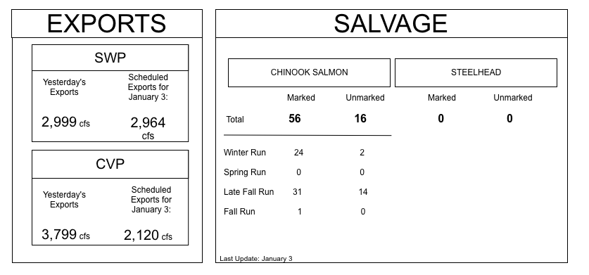
Sidebar Data Analysis Underway
Data Analysis
Wireframes
Key Decision Trees Wire Framed:
DCC Triggers (RPAs)
D-1641 WQ Parameters
Salmon Decision Tree
Drought Contingency Plan
JER and PPT Trigger Matrix
Water year classifications
Outflow

Slide 11
Tasks Completed
Data Management
Data Presentation
Data Analysis:
CPUE, RPAs/Biop/Decision Trees, All Trawl Data Comparison, Database Analysis, Indices,
Database and Web Services:
Database (master table) for Trawls, Traps, Ops, Trigger data, Indices Archive, Salvage
NOAA Weather and River Forecasting Services
Catch Indices
OMR Flows and Indices
Fish migration indicator stations: MLK, DCV, WLK, KN
Key Temperature and Indicator Stations
Dashboard HTML: Completed HTML and CSS for :
DJFMP Ops Dashboard
Recent Trawl Results
Weather and River Forecasting
Dashboard Integration: Link final services to templates.
Page Load Optimization: TBD. We will have a better idea about timeline these after all web services have been tested at scale.
TBD

Slide 12
DJFMP web Services (Tasks Completed)
Data Management
Data Management
The stationInfo service selects stations within a geographic bounding box.
It returns detailed information about the seine and trawl locations used through out the Delta.
Details include location name, identifier, and type of activities : seine, trawl and type of water quality measurements.
This service is mostly used to build getData requests which are listed below.
The getData service selects actual time series for the DJFMP locations.
Time series are available for catch, cpue, number of tows, dissolved oxygen, electrical conductivity, temperature, and secchi.
The service accepts time parameters indicating the start and end dates of the time series.
The results of this service may be used for reports, graphs, and animations.

Slide 13
DJFMP web Services (To Do)
Data Management
Data Services
New Stations
Database standardization
markCode for the getData request
RaceByLength for the getData request: Not Raced, Fall, LateFall, Adult, Spring, Winter, Hybrid, Late-Fall, Not required
regionCode: Catch and CPUE
Composite organismCode

Slide 14
Data (To Do)
Catch Highlights
 | GCID RST | Tidsdale RST | Knights Landing RST | Sacramento Trawl | Beach Seines | Sandy Beach Trawl | Chipps Island Midwater Trawl | Jersey Point Trawl | Prisoners Point Trawl | Mossdale Kodiak Trawl
Sample Date | 10/22-10/28 | 10/22-10/28 | 10/22-10/28 | 10/22-10/28 | 10/22-10/28 | 10/22-10/28 | 10/22-10/28 | 10/22-10/28 | 10/22-10/28 | 10/22-10/28
Total Catch | 321 | 3 | 5 | 3 | 3 | 0 | 0 | 2 | 4 | 0
Chinook (Fall-Run) | 1 | 0 | 1 | 1 | 1 | 0 | 0 | 0 | 0 | 0
Chinook (Winter Run) | 0 | 0 | 0 | 2 | 1 | 0 | 0 | 1 | 0 | 0
Chinook (Spring Run) | 2 | 0 | 0 | 0 | 0 | 0 | 2 | 0 | 0 | 0
Chinook (Late Fall Run) | 2 | 0 | 2 | 3 | 0 | 0 | 0 | 0 | 0 | 0
Chinook (Ad-Clipped) | 1 | 0 | 0 | 0 | 0 | 1 | 0 | 0 | 1 | 1
Delta Smelt | 1 | 0 | 0 | 0 | 0 | 0 | 0 | 0 | 1 | 0
Splittail | 0 | 1 | 0 | 0 | 2 | 0 | 0 | 0 | 1 | 0
Longfin Smelt | 0 | 0 | 4 | 2 | 0 | 0 | 1 | 1 | 0 | 0
Steelhead (Ad-Clipped) | 1 | 0 | 0 | 0 | 0 | 0 | 0 | 0 | 0 | 1
Steelhead (Wild) | 2 | 1 | 0 | 1 | 0 | 0 | 0 | 0 | 0 | 1

Slide 15
Timeline
Web Services: “Almost” complete. Denver to complete services requests for 4-10. These services are critical for filtering out races and developing compositions. Finalize new stations added.
34N estimate 40 hours
Data Processing: Complete composition and catch summaries queries. Testing with web services. Finalize time filtering methods.
34N estimate 30 hours
Dashboard Integration: Link final services to templates.
34N estimate 40 hours
Page Load Optimization: TBD. Will have a better idea about timeline these after all web services have been tested at scale.
TBD
Additional Data: Glenn Colusa, Salvage, Tidsdale, Knights landing TBD (approximately 2 weeks)

Slide 16
CAMT/DOSS GIS

Slide 17
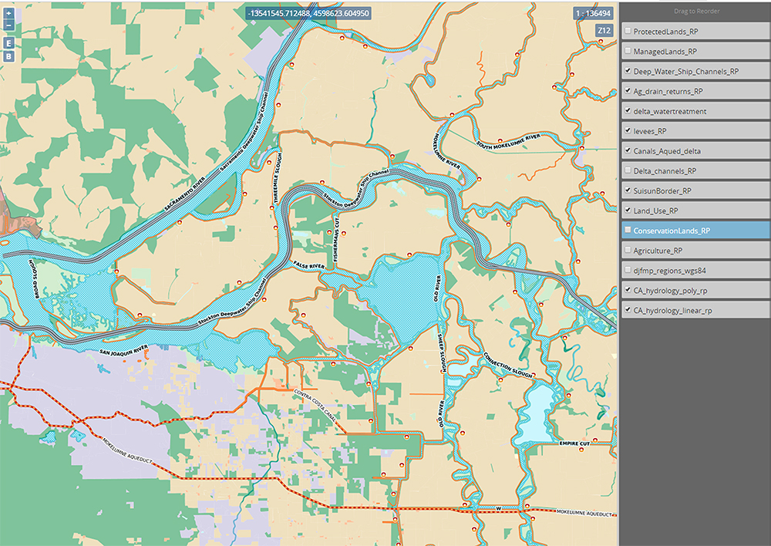

Slide 18
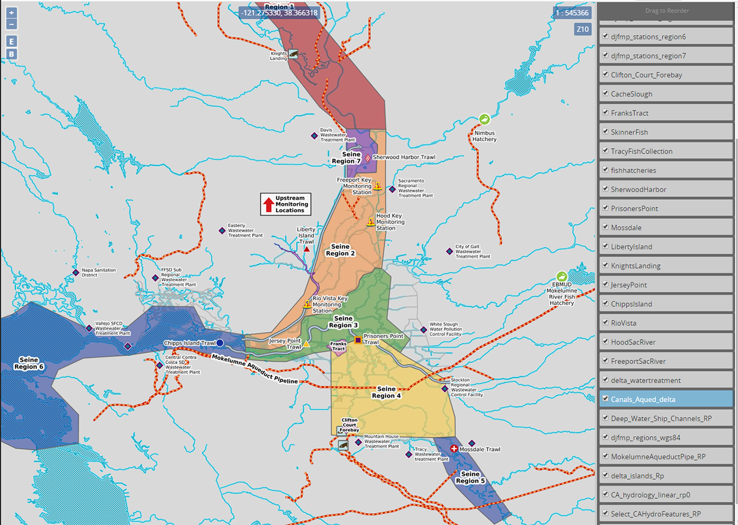

Slide 20
CAMT/DOSS Dashboard Comps

Slide 21
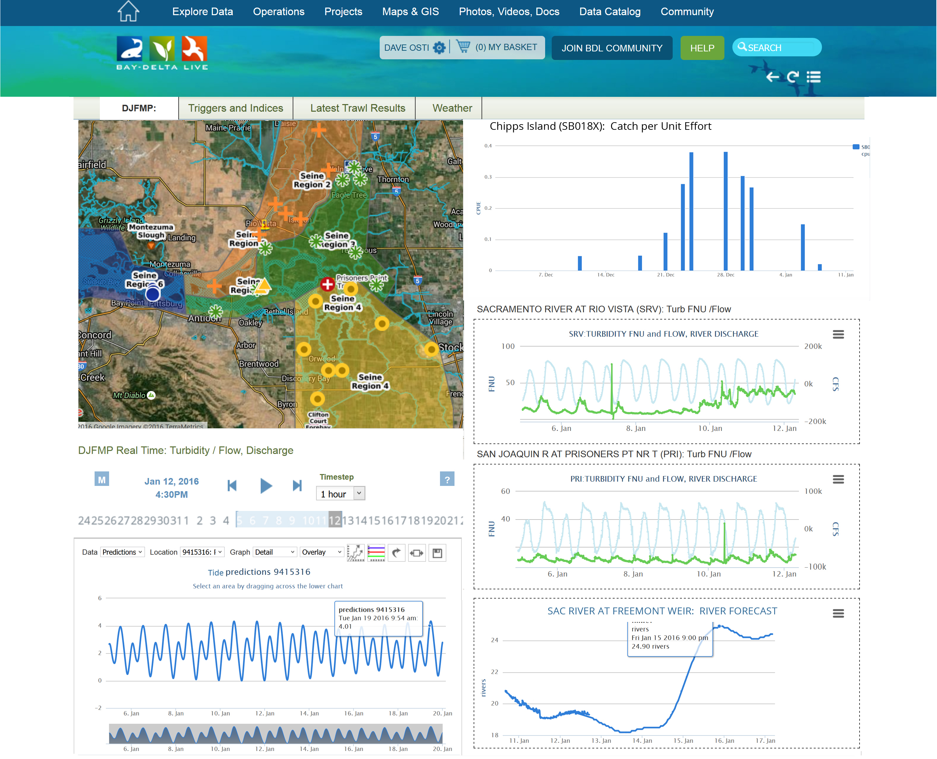

Slide 22
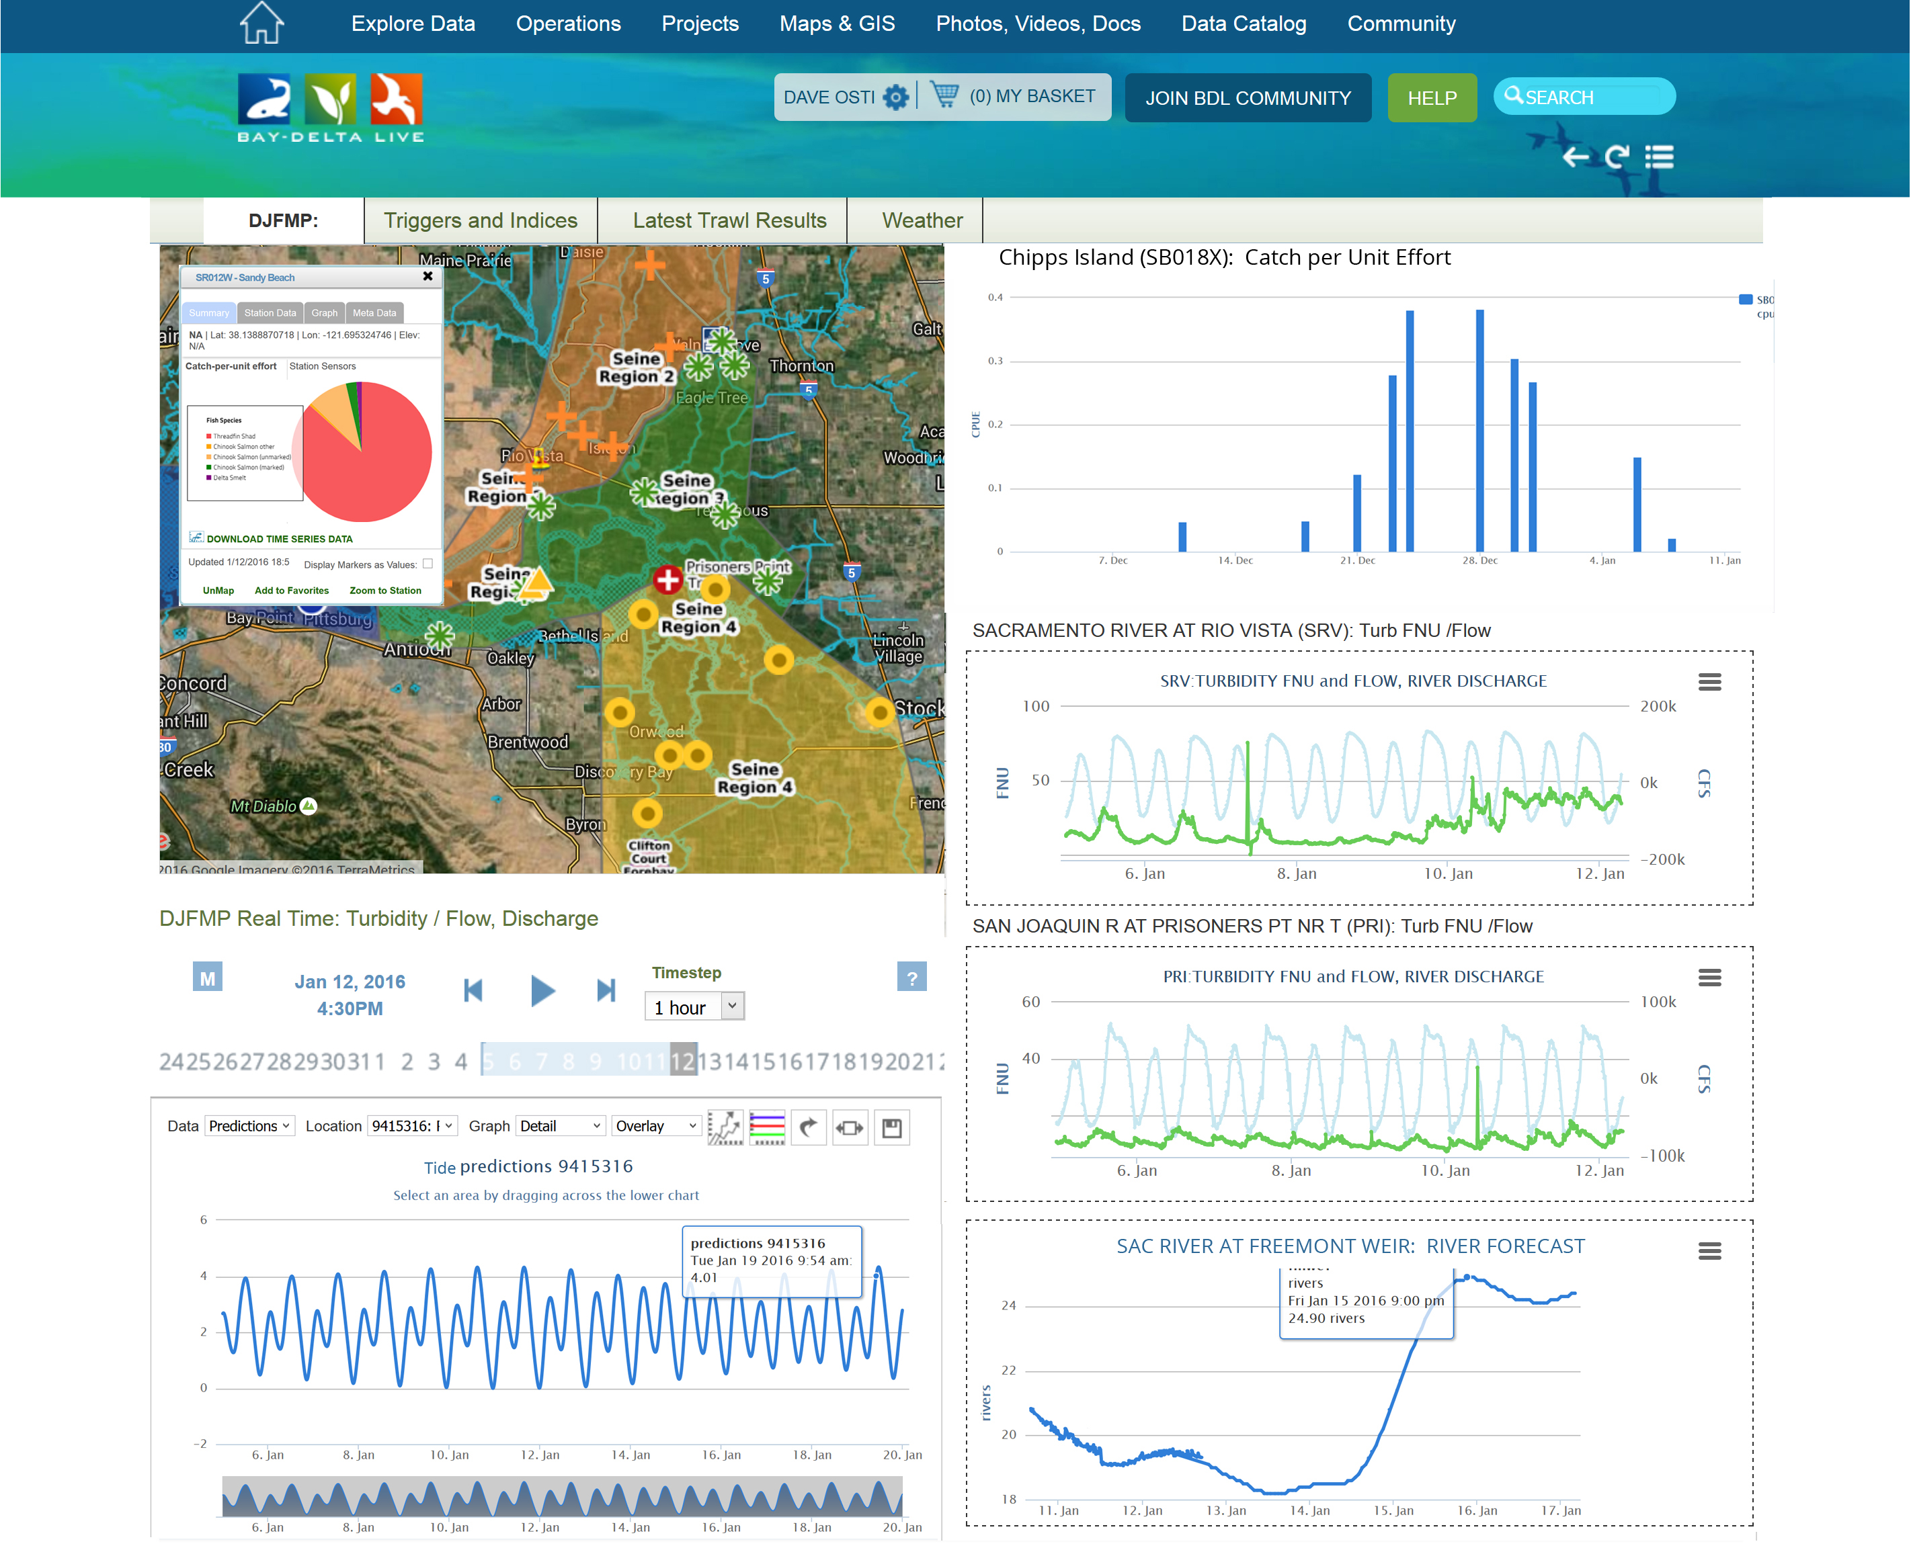

Slide 23
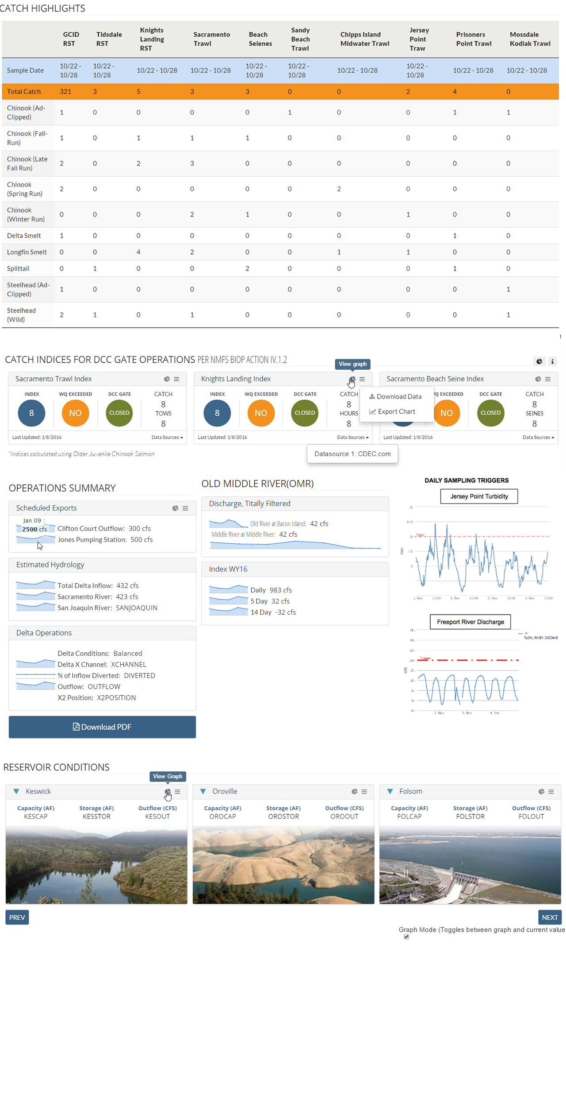

Slide 26
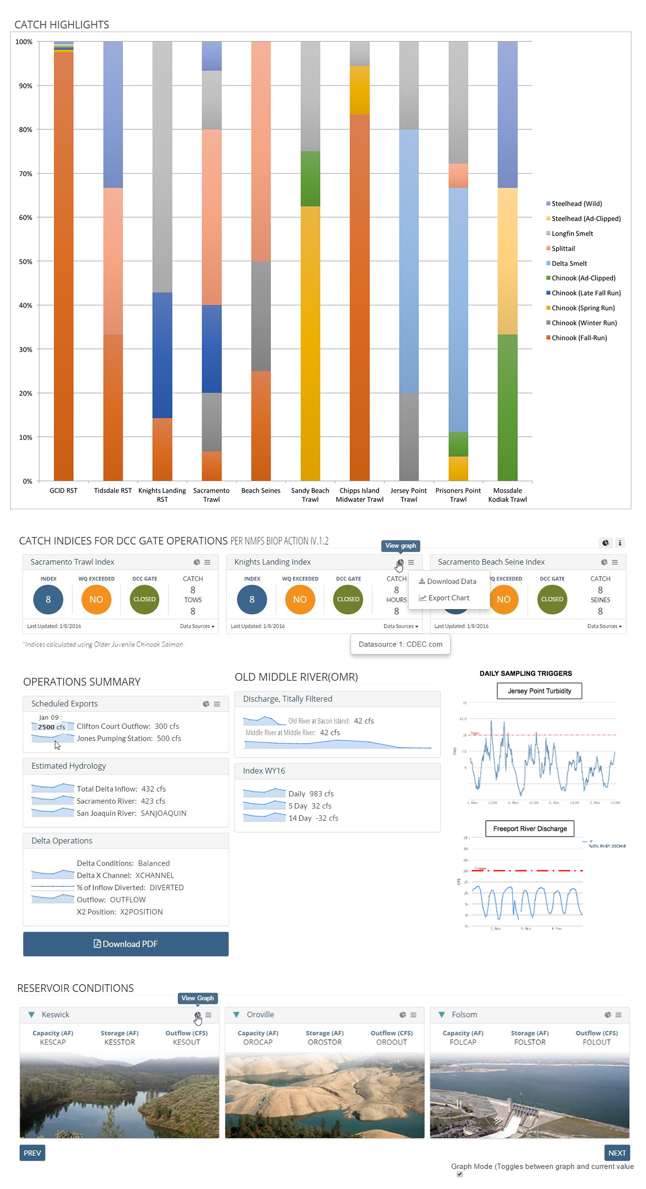

Slide 27
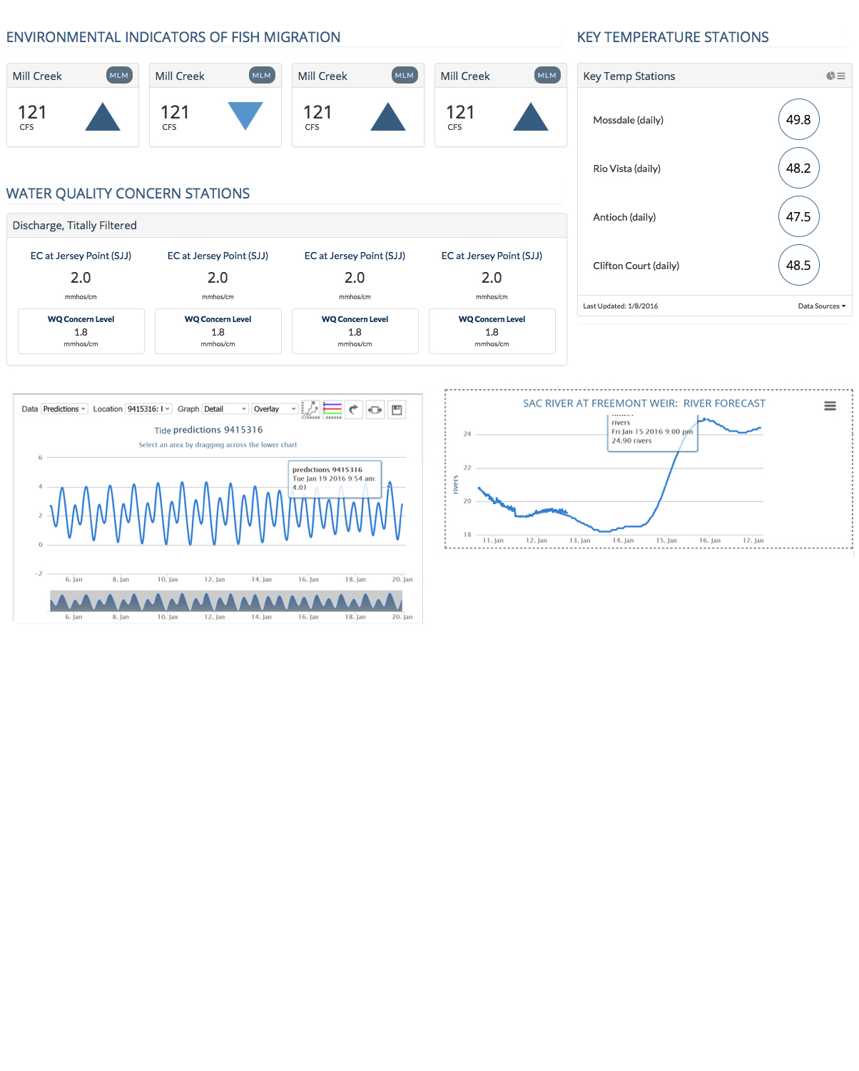

Slide 28
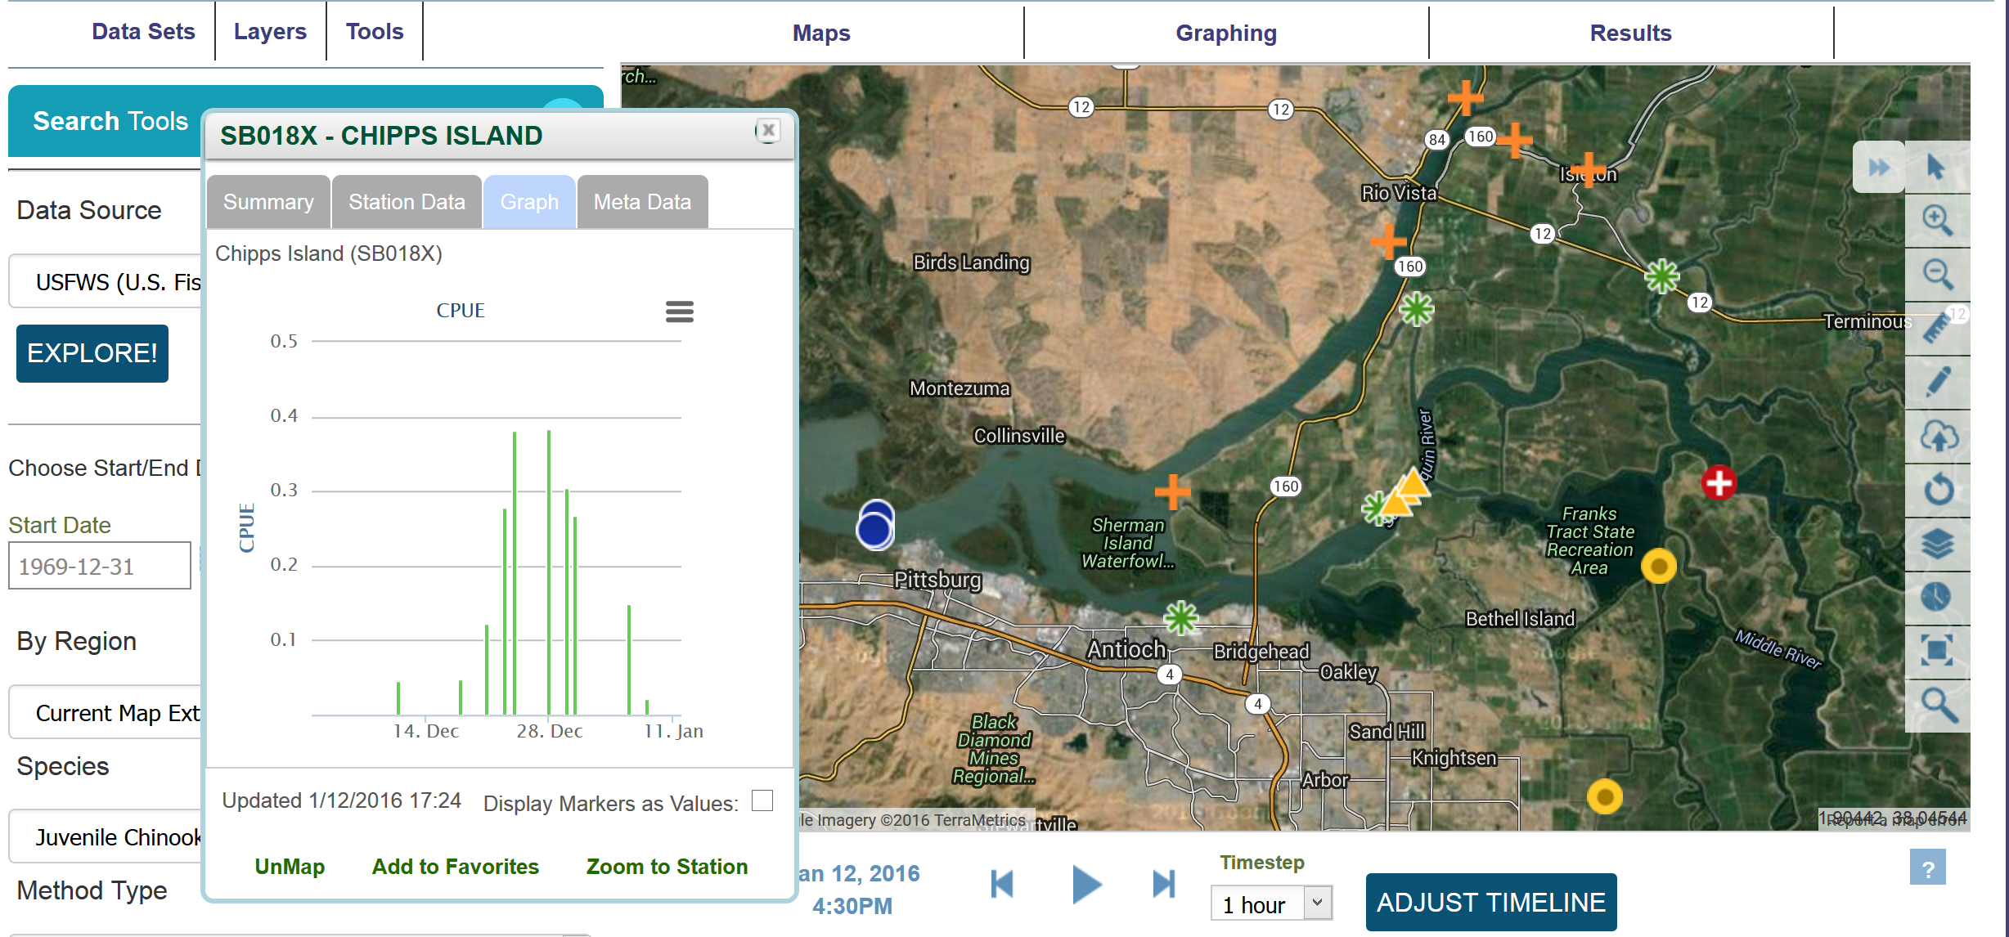

Slide 29
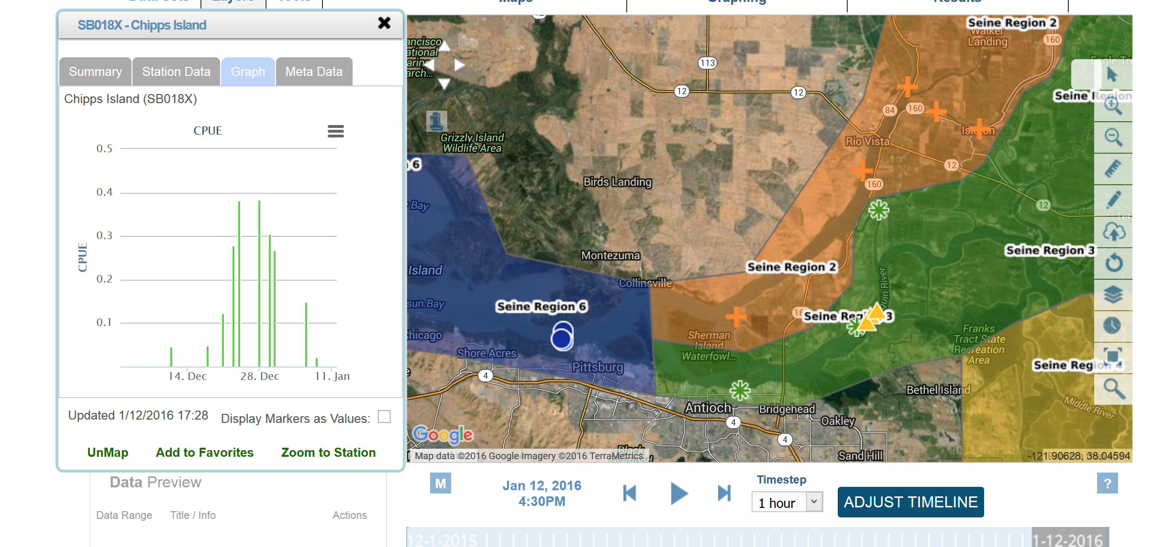

Slide 30
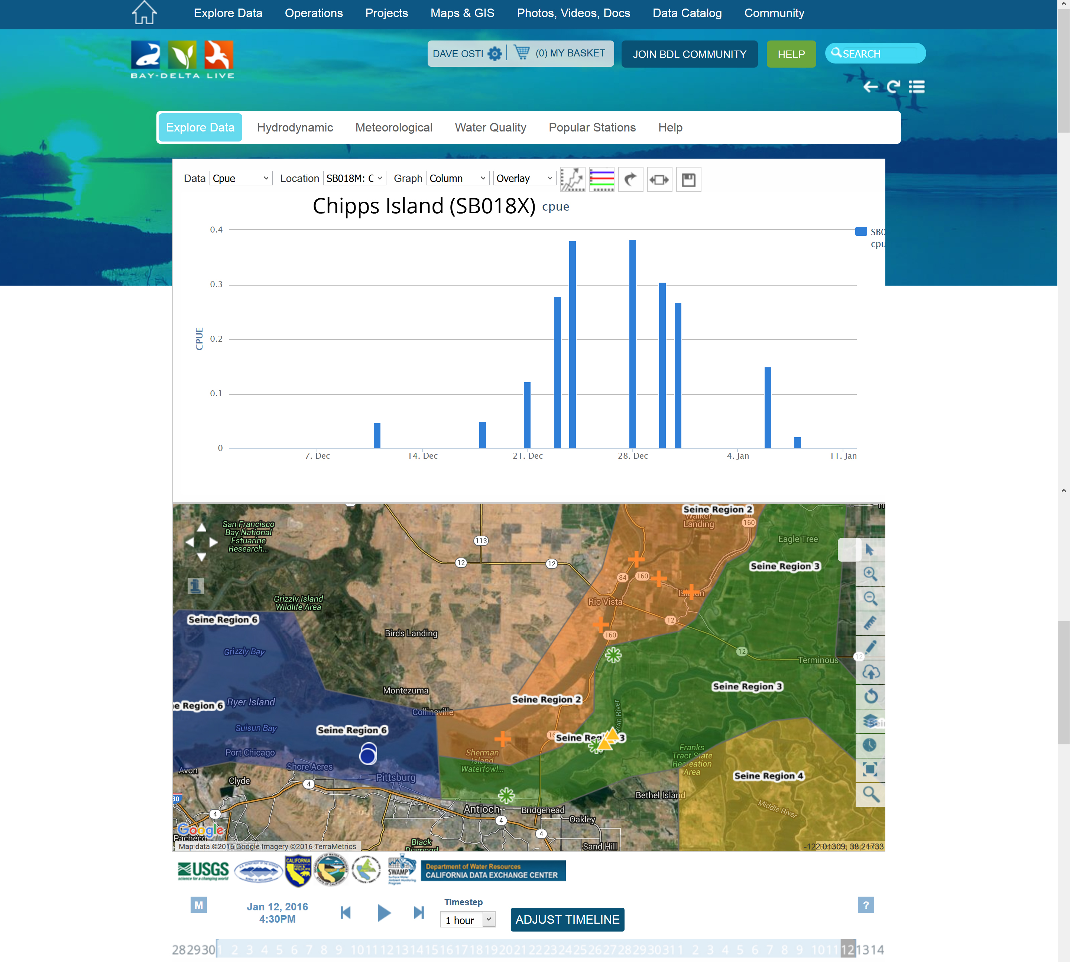

Slide 31
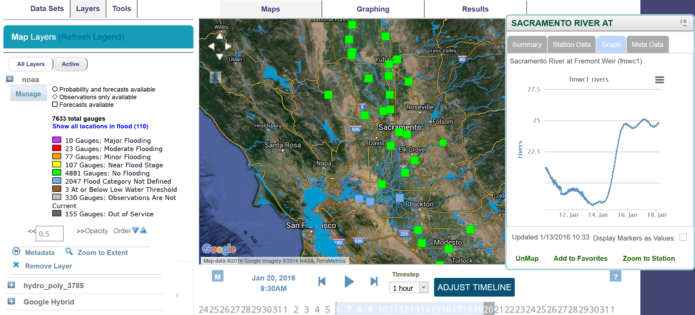

Slide 32
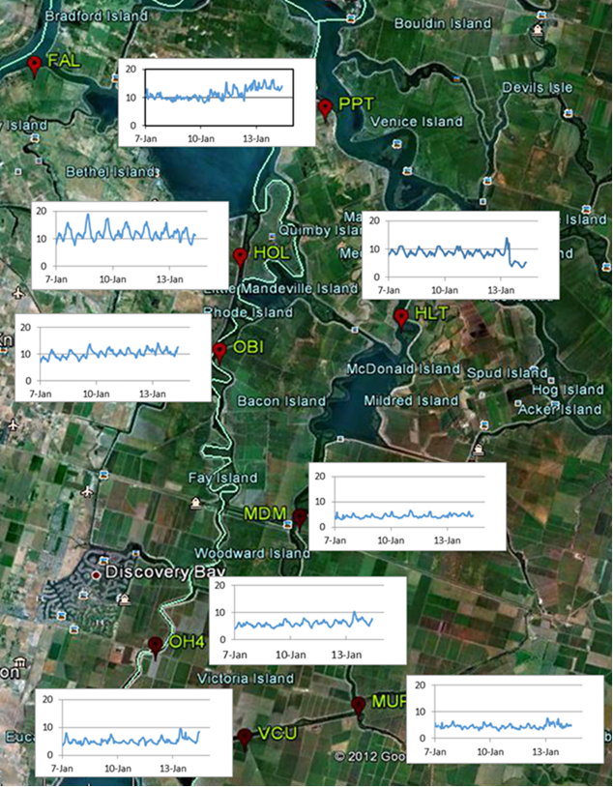
Turbidity History 2016

Slide 33
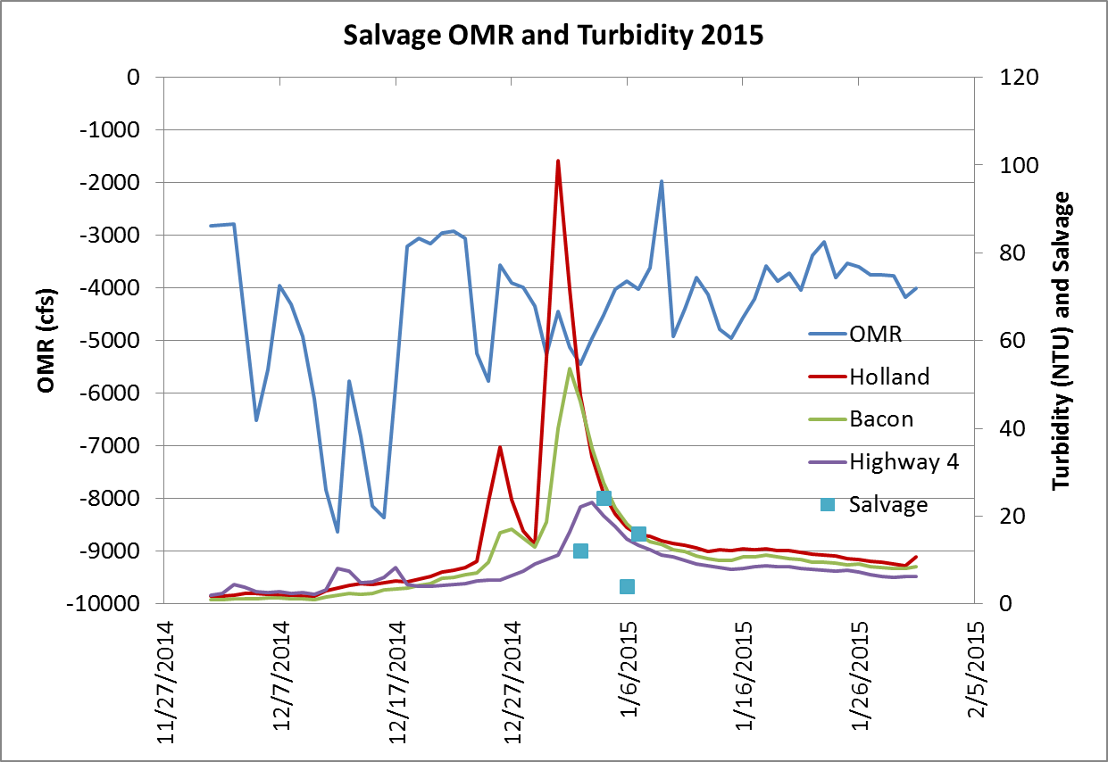
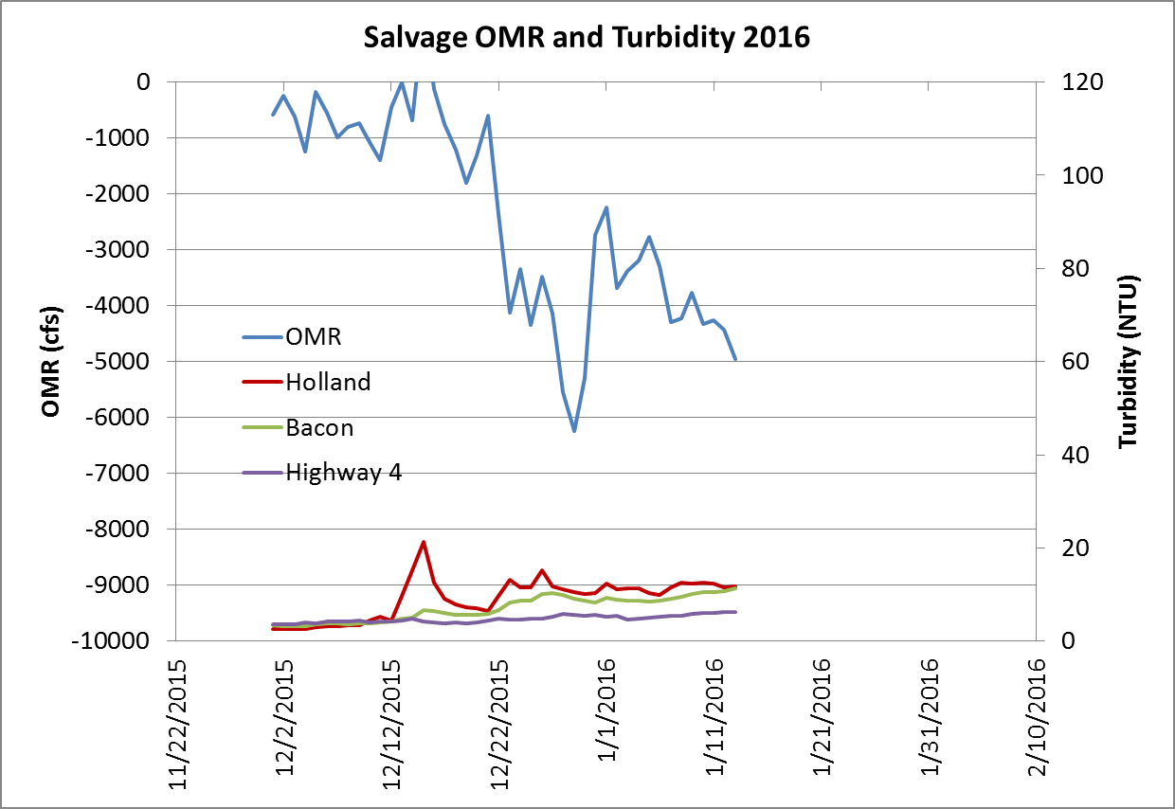
Turbidity Event 2015
Turbidity Non Event 2016

Slide 34
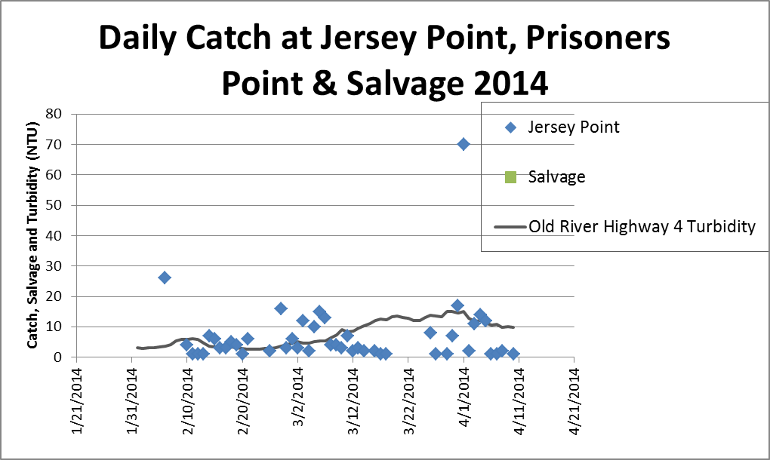
Salvage V Jersey Catch and Turbidity 2014
No salvage despite high Jersey Point Catch

Slide 35
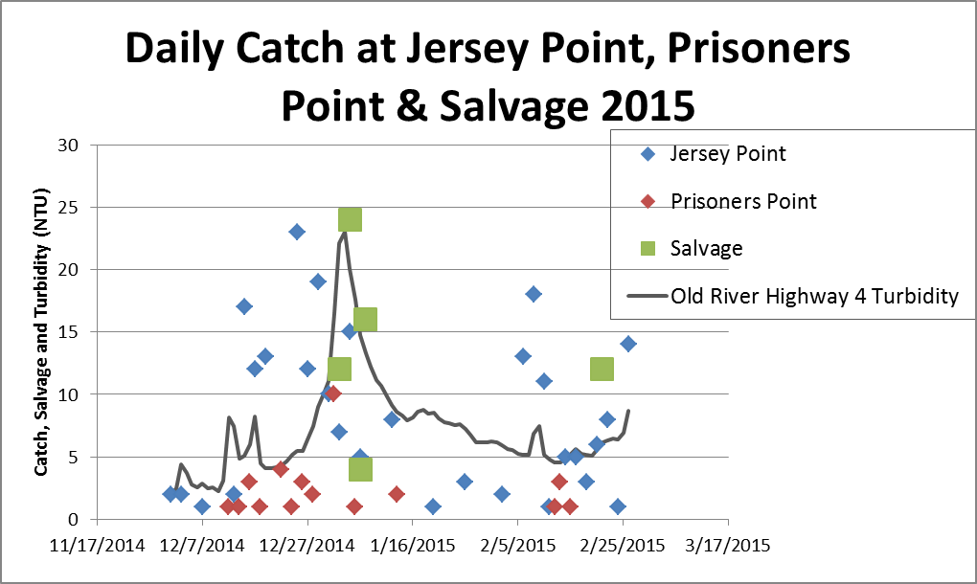
Salvage V Jersey Catch and Turbidity 2015
Continuous Jersey Point catch, but Salvage only during Turbidity Event

Slide 36
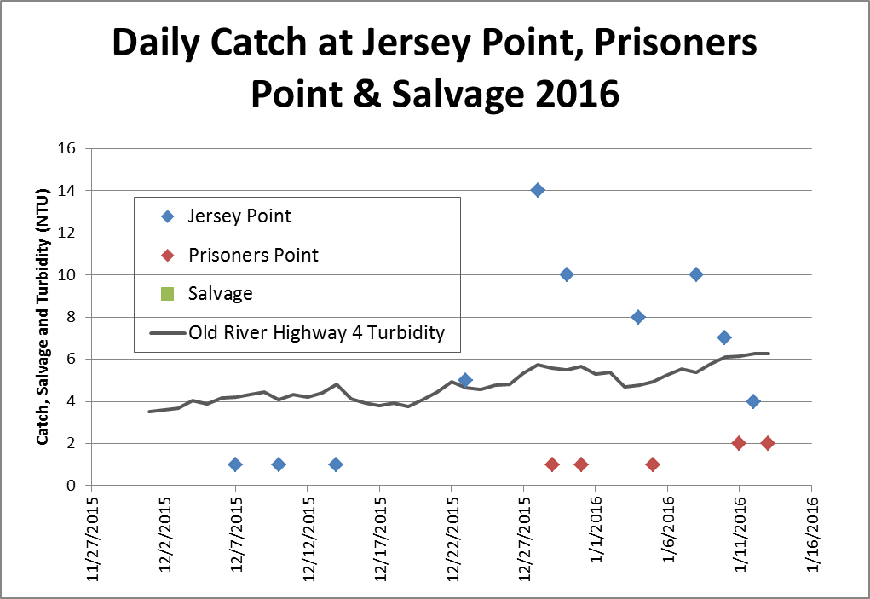
Salvage V Jersey Catch and Turbidity 2016
Continuous Jersey Point catch, but no turbidity event and no salvage

Slide 37

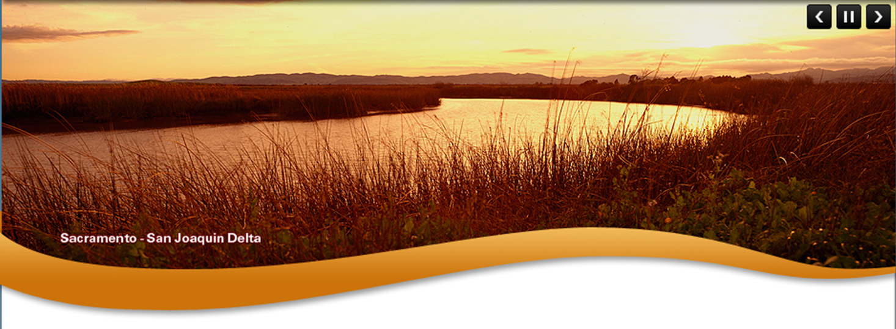
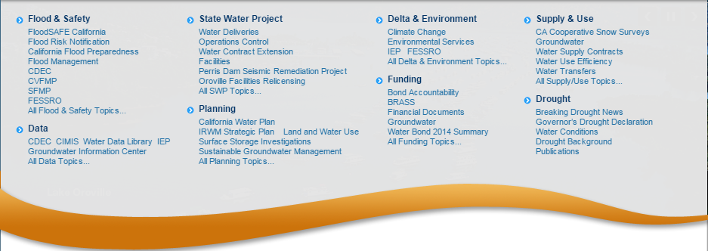



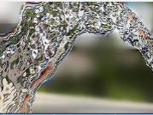
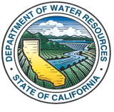
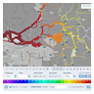

WATER QUALITY MONITORING COUNCIL
CALIFORNIA ESTUARIES PORTAL
Search
PORTALS
CA ESTUARIES
LEARN THE ISSUES
REPORTING
MANAGEMENT TOOLS
San Francisco Estuary
Benthic Invertebrates
Santa Monica Bay
Elkhorn Slough
Morro Bay Estuary
Smith River Estuary
Klamath River Estuary
Mad River Estuary
Noyo River Estuary
Eel River Estuary
Russian River Estuary
Safe
ABOUT US
STEWARDSHIP
WATER NEWS
What is the Estuary Monitoring Workgroup?
What is being done to protect California’s Estuaries?
What are headlines in California’s water news?
The California Estuary Monitoring Workgroup, is tasked with identifying key questions to assess the
It is every citizen’s responsibility acting as a steward in protecting the environment. The Sacramento
A new weather satellite was launched (February 27) from Japan aimed at providing high-tech, three
Ecological health of California’s Estuaries, the data and methods available and needed to address the questions, and the methods to access these data. Learn more
Regional County Sanitation District is in the process of purchasing and restoring habitat surrounding the their treatment plant…. Learn more
Dimensional snowfall around the earth. The Global Precipitation Measurements…. Learn more
HIGHLIGHTS
Safe
REPORTING
MANAGEMENT TOOLS
RESEARCH
What is the Water Quality Conditions Report?
How is salinity being managed during the drought?
How are tagged fish being used in the Delta?
This report summarizes the results of water quality monitoring and special studies conducted by the
Building data stories to communicate complicated topics. Learn about Salinity, why it is important and the
In support of various fish tracking studies by the Army Corp, USGS, MWD, DWR and participating
Environmental Monitoring Program within the Sacramento-San Joaquin Delta and Suisun Marsh, as mandated by Water Rights Decision 1641 (D-1641). Learn more
Management options available to the resource agencies. See real time conductivity conditions, visualize the salt field and spatially view….. Learn more
Agencies for management of receiver network ops and visualization of raw processed…. Learn more

Slide 38
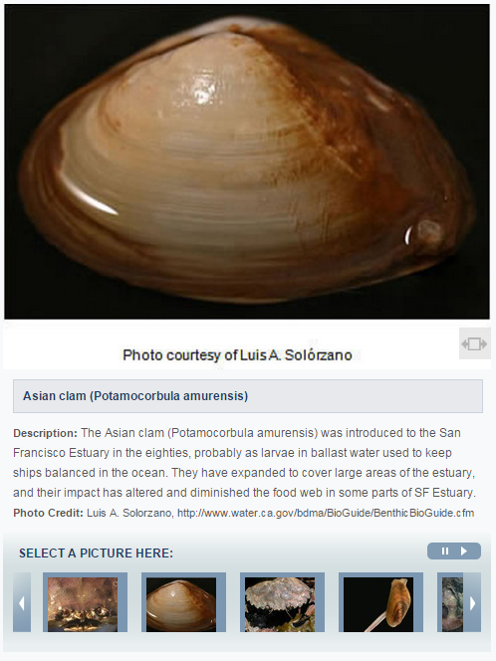
WATER QUALITY MONITORING COUNCIL
CALIFORNIA ESTUARIES PORTAL
Search
PORTALS
CA ESTUARIES
LEARN THE ISSUES
REPORTING
MANAGEMENT TOOLS
Benthic Invertebrates
What Are they?
How are they monitored?
Reporting
SAN FRANCISCO BAY DELTA ESTUARY
Benthic organisms are creatures that live at the bottom of water bodies. They include common invertebrates (animals without backbones) like clams, shrimp, and crabs and other less recognized creatures including worms, little crustaceans called amphipods, and aquatic insects. These organisms live in or on the soft mud of the Estuary, while others attach themselves to rocks and other hard surfaces. There are also benthic vertebrates (animals with backbones) that include various fish species among other creatures.
Many benthic organisms are filter feeders. They pump water through their bodies or through holes they have burrowed in the mud to catch food suspended in the water. Others graze on food they find in and on the surface of the bottom. Filter feeders and grazers eat phytoplankton, zooplankton, other benthic organisms, and/or decaying organic debris washed in from the surrounding watershed.
Why Are Benthic Organisms Important?
Benthic organisms are important part of the estuarine food web. They consume and are consumed by other creatures. Every winter during low-tides, thousands of migrating shorebirds feast themselves upon uncovered clams, crabs, and worms found in the mudflats. Humans, as well, take advantage of the low-tides to harvest their own feast. Certain fish species, including juvenile salmon, striped bass, and sturgeon, also consume many types of benthic organisms.
A large percentage of the benthic organisms found in the SF Estuary are invasive and thus can have negative effects on the health of the estuary.
Filter feeding benthic organisms pump immense amounts of water through their bodies, consuming large amounts of the available phytoplankton biomass in the estuary.
Historically, bay shrimp supported a large commercial fishery in the Bay, and California’s commercial crab fishery still depends upon crabs that spend the first two years of their life growing in the SF Estuary.
Changes in benthic organisms’ populations also can be indications of larger changes in the physical conditions of the SF Estuary, including alterations in freshwater inflows, salinity, and sediment composition. These changes can then affect other living things and general water quality.

Slide 39
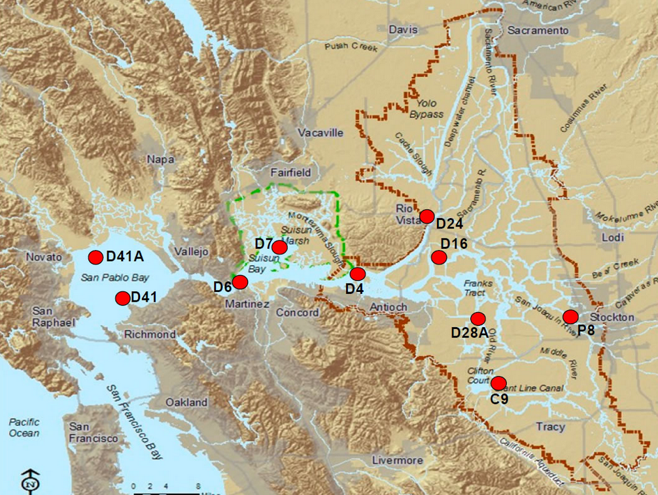
WATER QUALITY MONITORING COUNCIL
CALIFORNIA ESTUARIES PORTAL
Search
PORTALS
CA ESTUARIES
LEARN THE ISSUES
REPORTING
MANAGEMENT TOOLS
Benthic Invertebrates
What Are they?
How are they monitored?
Reporting
SAN FRANCISCO BAY DELTA ESTUARY
Department of Water Resources Benthic Organism Study
The California DWR Benthic Organism Study measures the composition (what kinds?), abundance (how many?), diversity (how many kinds?), and distribution (where are they?) of benthic organisms as part of the IEP’s Environmental Monitoring Program (EMP). Changes in their composition, abundance, diversity, and distribution are documented within the SF Estuary, from San Pablo Bay east through the upper Estuary to the mouths of the Sacramento, Mokelumne, and San Joaquin Rivers.
Ten sites are currently sampled. Because different benthic species live in different parts of the Estuary, the sites represent a wide range of habitats of varying sizes and physical conditions, including different types of salinity and sediment composition. Sites range from narrow, freshwater channels in the Delta to broad, estuarine bays.
Samples are collected monthly. From 1975 to 1979, biannual sampling was conducted in late spring and fall. Monthly sampling started in June 1980 and ended in October 2003. Samples were collected quarterly from October 2003 through October 2005, after which monthly sampling was resumed. Sediment samples are also collected at each site for sediment analysis.
Learn more about the methods used to measure benthic organisms.
Department of Fish and Wildlife San Francisco Bay Study
EMP monitoring sites, however, are not as good for accurately sampling shrimp and crabs, but the CDFW San Francisco Bay Study surveys collect crabs and shrimp monthly using an otter trawl. Thirty-five fixed monitoring stations are distributed evenly throughout four sub-regions of the estuary, including South, Central, San Pablo, and Suisun Bays.
More information on benthic organisms and their monitoring can be found in the DWR Benthic Organism Meta Data ,the Benthic BioGuide, the Benthic Dictionary, and the CDFW San Francisco Bay Study.
For more information regarding sediment composition data, please contact Karen Gehrts.
Rather than having interactive maps, users will select monitoring program to populate a static map above.
To view the locations of phytoplankton and chlorophyll-a monitoring stations in the map above, please select:
Monitoring Program?

Slide 40

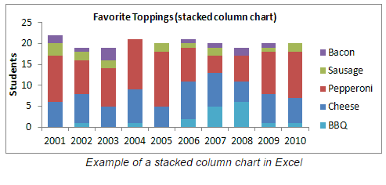
WATER QUALITY MONITORING COUNCIL
CALIFORNIA ESTUARIES PORTAL
Search
PORTALS
CA ESTUARIES
LEARN THE ISSUES
REPORTING
MANAGEMENT TOOLS
User’s will be able to access “Reporting” information and data in various ways.
Benthic Invertebrates
SELECT DATA
What Are they?
How are they monitored?
Reporting
Where?
SAN FRANCISCO BAY DELTA ESTUARY
When?
A brief introductory paragraph will be provided for D1641 (or other mandated reporting)
Water Rights Decision 1641 Compliance
The SWRCB establishes water quality objectives and monitoring plans to protect the variety of beneficial uses of the water within the upper San Francisco estuary (estuary). The SWRCB ensures that these objectives are met, in part, by inclusion of water quality monitoring requirements into water rights decisions issued to DWR and USBR as conditions for operating the SWP and CVP, respectively. These requirements include minimum outflows, limits to water diversion by the SWP and CVP, and maximum allowable salinity levels. In addition, DWR and USBR are required to conduct a comprehensive monitoring program to determine compliance with the water quality objectives and report the findings to the SWRCB. Water quality objectives were issued in December 1999 by D-1641 (SWRCB, 1999) and revised by order WR 2000-02 in March 2000.
2015 Summary
The benthic monitoring program is designed to document the distribution, diversity, and abundance of benthic (bottom dwelling) organisms in the estuary. Geographic coverage of the sampling sites ranges from the eastern region of San Pablo Bay through the Delta to the mouths
of the Sacramento, Mokelumne, and San Joaquin rivers. The benthic community of the estuary is a diverse assemblage of organisms, which includes worms, crustaceans, insects, and molluscs. This program monitors both benthic macrofauna (organisms larger than 0.5 mm) and sediment composition (Lehman et al., 2001). General trends in sediment composition are documented at the same sites where benthic samples are collected.
To view prior year ‘s summaries or an archive of prior reports, please click here.
What Species?
Understanding the relative abundance and distribution of benthic invertebrates in the San Francisco Bay Delta Estuary.
Station: D41
X
Y
The current year’s summary will be provided (updated annually). Users will be able access prior summaries and annual reports via link to (DWR?).
Species A
Count
Species B
Species C
Species D
Species E
Download: Graph Data Metadata
Station: D28A
X
Y
Species A
Count
Species B
Species C
Species D
Species E
Download: Graph Data Metadata
Station: P8
X
Y
Species A
Count
Species B
Species C
Species D
Species E
Download: Graph Data Metadata

Slide 41
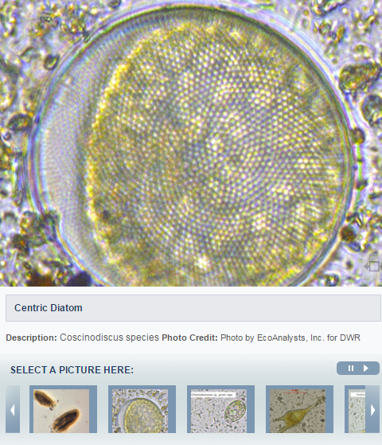
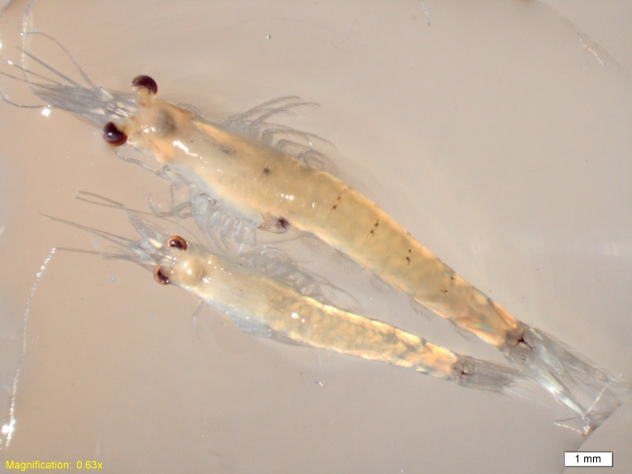
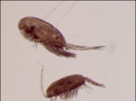
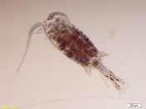
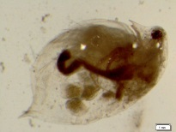
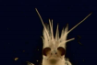
WATER QUALITY MONITORING COUNCIL
CALIFORNIA ESTUARIES PORTAL
Search
PORTALS
CA ESTUARIES
LEARN THE ISSUES
REPORTING
MANAGEMENT TOOLS
Zooplankton
What Are they?
How are they monitored?
Reporting
SAN FRANCISCO BAY DELTA ESTUARY
Zooplankton are small aquatic invertebrates (animals without backbones) that drift in the water with prevailing currents. Although they do not have the ability to swim against currents, they use behaviors such as vertical migration to maintain their approximate positions in the estuary. They include mysids (sometimes referred to as opossum shrimp because of the pouch they use to carry their eggs and their resemblance to tiny shrimp), some amphipods, copepods, cladocerans, and rotifers.
Zooplankton are pelagic and live in the open-water portions of the estuary, some are epibenthic and are found near the bottom of the water column, and some are associated with submerged aquatic vegetation and are found clinging to vegetation. Some zooplankton are grazers that eat phytoplankton, ciliates, and detritus. Other zooplankton are predatory and eat smaller zooplankton.
Why Are Zooplankton Important?
Zooplankton is an important component of the estuarine food web. They eat phytoplankton and in turn are eaten by other zooplankton, aquatic insects, and fish; thereby providing an important trophic link between primary producers and fish. Most larval and juvenile fish eat zooplankton and some smaller fish, such as Delta Smelt and Longfin Smelt, rely on zooplankton for food throughout their lives.
Most of the zooplankton in the upper San Francisco Estuary have declined in abundance since monitoring began in 1972, particularly native species. Currently most of the abundant zooplankton are non-native invasive species, some of which are not good fish food.
The introduced clam Potamocorbula amurensis drastically reduced the available phytoplankton in the low salinity zone of the estuary, which reduced food availability for zooplankton and caused many zooplankton species to decline. This resultant zooplankton decline has been implicated as one of the many causes of the Pelagic Organism Decline (POD), which described the dramatic decline of several pelagic fish species concurrently.
Changes in the abundance, distribution, and community composition of zooplankton in the estuary can be indications of larger changes in the physical conditions of the SF Estuary, including alterations in freshwater flows, salinity, and temperature.
Species X

Slide 42
WATER QUALITY MONITORING COUNCIL
CALIFORNIA ESTUARIES PORTAL
Search
PORTALS
CA ESTUARIES
LEARN THE ISSUES
REPORTING
MANAGEMENT TOOLS
Zooplankton
What Are they?
How are they monitored?
Reporting
SAN FRANCISCO BAY DELTA ESTUARY
Department of Fish and Wildlife’s Zooplankton Study
The California Department of Fish and Wildlife’s Zooplankton Study determines the composition (what kinds?), abundance (how many?), and distribution (where are they?) of zooplankton in the upper San Francisco Estuary as part of the Interagency Ecological Program’s Environmental Monitoring Program (EMP). The Zooplankton Study monitors zooplankton in the upper San Francisco Estuary from San Pablo Bay east through the Delta.
Between seventeen and twenty fixed sites are currently sampled monthly (Figure 1), depending on the electrical conductance of the water. Additional floating (non-fixed) sites are sampled in the entrapment zone; the locations of these sites varies monthly and is determined by the electrical conductivity of the water (a surrogate for salinity). Entrapment zone stations are sampled where the bottom electrical conductivity is two milliSiemens per centimeter and six milliSiemens per centimeter. When the entrapment zone is located upstream of the confluence of the Sacramento and San Joaquin rivers, the entrapment zones in each of these rivers are sampled separately.
Since 1995, zooplankton samples from each site have been collected monthly during the DWR Water Quality Run. Prior to 1995, the winter months, December through February, were not always sampled. During some years from 1972 through 1993, the spring and summer months were sampled twice monthly. Water quality and phytoplankton samples are collected at each site.
Three gear types are used at each sampling site to target different sizes of zooplankton: 1) a pump for sampling microzooplankton <1.0 mm long, including rotifers, copepod nauplii, and adult copepods of the genus Limnoithona; 2) a modified Clarke-Bumpus (CB) net for sampling mesozooplankton 0.5-3.0 mm long, including cladocerans, copepodids (immature copepods), and adult copepods; and 3) a macrozooplankton net for sampling zooplankton 1-20 mm long, which targets mysid shrimp.
Learn more about the methods used to sample zooplankton.
More information on zooplankton monitoring in the upper San Francisco Estuary can be found on the CDFW Zooplankton Study website, as well as the EMP Zooplankton Metadata.
To view the locations of zooplankton monitoring stations in the map above, please select:
Monitoring Program?

Slide 43
WATER QUALITY MONITORING COUNCIL
CALIFORNIA ESTUARIES PORTAL
Search
PORTALS
CA ESTUARIES
LEARN THE ISSUES
REPORTING
MANAGEMENT TOOLS
34N—need to figure out way of select data from multiple surveys, gear types etc. (zoo/fish data)
Zooplankton
SELECT DATA
What Are they?
How are they monitored?
Reporting
Where?
SAN FRANCISCO BAY DELTA ESTUARY
When?
Water Rights Decision 1641 Compliance
The SWRCB establishes water quality objectives and monitoring plans to protect the variety of beneficial uses of the water within the upper San Francisco estuary (estuary). The SWRCB ensures that these objectives are met, in part, by inclusion of water quality monitoring requirements into water rights decisions issued to DWR and USBR as conditions for operating the SWP and CVP, respectively. These requirements include minimum outflows, limits to water diversion by the SWP and CVP, and maximum allowable salinity levels. In addition, DWR and USBR are required to conduct a comprehensive monitoring program to determine compliance with the water quality objectives and report the findings to the SWRCB. Water quality objectives were issued in December 1999 by D-1641 (SWRCB, 1999) and revised by order WR 2000-02 in March 2000.
2015 Summary
The Zooplankton Study was designed to monitor the abundance and distribution of zooplankton in order to assess trends in fish food resources in the upper San Francisco Estuary. Geographic coverage of the sampling sites ranges from the eastern region of San Pablo Bay through the Delta. The zooplankton community is comprised of a diverse assemblage of organisms, which includes mysids, copepods, amphipods, cladocerans, and rotifers.
To view prior year ‘s summaries or an archive of prior reports, please click here.
What Species?
Understanding the relative abundance and distribution of Zooplankton in the San Francisco Bay Delta Estuary.
Station: D41
X
Y
Species A
Count
Species B
Species C
Species D
Species E
Download: Graph Data Metadata
Station: D28A
X
Y
Species A
Count
Species B
Species C
Species D
Species E
Download: Graph Data Metadata
Station: P8
X
Y
Species A
Count
Species B
Species C
Species D
Species E
Download: Graph Data Metadata

Slide 44
WATER QUALITY MONITORING COUNCIL
CALIFORNIA ESTUARIES PORTAL
Search
PORTALS
CA ESTUARIES
LEARN THE ISSUES
REPORTING
MANAGEMENT TOOLS
Phytoplankton
What Are they?
How are they monitored?
Reporting
SAN FRANCISCO BAY DELTA ESTUARY
Phytoplankton are small organisms that can be found floating in most water bodies. Like plants, they are primary producers; they convert light energy from the sun and carbon dioxide into the living matter of their cells through photosynthesis. Phytoplankton from the San Francisco Estuary fall into four broad categories: cyanobacteria, diatoms, green algae, and various flagellate groups.
Why Are Phytoplankton Important?
Phytoplankton are the foundation of the aquatic food web. They feed a diverse array of organisms, ranging from microscopic zooplankton to large pelagic fish. Small fish and benthic organisms also graze on phytoplankton, and are in turn consumed by larger organisms such as birds. Changes in phytoplankton in the San Francisco Estuary can have cascading effects throughout the food web.
Phytoplankton can affect elements of water quality, including:
pH
Dissolved oxygen
Taste and odor of drinking water
Water transparency
Large algal blooms, both toxic and non-toxic, can have adverse effects on the water quality parameters listed above. They can also have negative aesthetic effects by forming large, floating surface scums.
Monitoring changes in phytoplankton can be useful in assessing water quality trends. It is important to note, however, that because of the transient and patchy nature of phytoplankton, their use as water quality indicators is limited and should be interpreted in conjunction with chemical, physical, and biological data.
Chlorophyll-a is the primary photosynthetic product made by phytoplankton and plants, and gives them their green color. Sometimes the green color is masked by secondary pigments, and these phytoplankton often appear brown or red instead of green. Chlorophyll-a is also a measure of the biomass that is directly available to organisms that prey on phytoplankton, such as clams and zooplankton.

Slide 45
WATER QUALITY MONITORING COUNCIL
CALIFORNIA ESTUARIES PORTAL
Search
PORTALS
CA ESTUARIES
LEARN THE ISSUES
REPORTING
MANAGEMENT TOOLS
Phytoplankton
What Are they?
How are they monitored?
Reporting
SAN FRANCISCO BAY DELTA ESTUARY
Department of Water Resources Phytoplankton and Chlorophyll-a Monitoring
The California DWR Phytoplankton and Chlorophyll-a Monitoring measures the composition (what kinds?), abundance (how many?), diversity (how many kinds?), and distribution (where are they?) of phytoplankton as part of the IEP’s Environmental Monitoring Program (EMP). It also measures phytoplankton biomass as chlorophyll-a. Changes in phytoplankton composition, abundance, diversity, distribution, and biomass are documented throughout the San Francisco Estuary, from San Pablo Bay east through the upper Estuary to the mouths of the Sacramento, Mokelumne, and San Joaquin Rivers.
Thirteen fixed sites are currently sampled (Figure 1), with two additional sites sampled where the bottom specific conductance is 2,000 and 6,000 micro-Siemens, respectively. Specific conductance is used as a proxy for salinity, with higher values corresponding to higher salinity. The physical location of these sites varies based on where the target specific conductance values are found. Because different phytoplankton species live in different parts of the Estuary, the sites represent a wide range of habitats of varying physical conditions, including wide ranges of salinity and temperature. Sites range from narrow, freshwater channels in the Delta to broad, estuarine bays.
Currently samples are collected monthly. Water is sampled from 1 meter below the surface. Whole water samples are collected for phytoplankton composition; water is filtered onto glass carbon fiber filters for chlorophyll-a analysis.
Learn more about the methods used to analyze phytoplankton and chlorophyll-a.
To view the locations of phytoplankton and chlorophyll-a monitoring stations in the map above, please select:
Monitoring Program?

Slide 46
WATER QUALITY MONITORING COUNCIL
CALIFORNIA ESTUARIES PORTAL
Search
PORTALS
CA ESTUARIES
LEARN THE ISSUES
REPORTING
MANAGEMENT TOOLS
Phytoplankton
SELECT DATA
What Are they?
How are they monitored?
Reporting
Where?
SAN FRANCISCO BAY DELTA ESTUARY
When?
Phytoplankton and Chlorophyll-a Monitoring
Phytoplankton samples are counted using an inverted microscope. Phytoplankton are identified to the lowest taxonomic level possible (usually genus or species) and counted. The counts are used to calculate organisms per milliliter.
There is often a large number of different genera and species in a single sample, so phytoplankton are usually grouped at a higher taxonomic level for reporting purposes (e.g. diatoms, cyanobacteria). While individual species can be restricted to certain habitats with specific physico-chemical characteristics, higher taxonomic groups such as diatoms are often widespread and cosmopolitan.
Chlorophyll-a varies widely throughout the San Francisco Estuary, and is affected by factors such as day length, temperature, nutrients, turbidity, and residence time (how long phytoplankton are in one location). In Suisun Bay, filtering by the clam Potamocorbula amurensis has drastically altered the planktonic community since 1987, and chlorophyll-a levels in this region remain very low compared to other areas of the Estuary.
In some upstream areas of the Estuary, chlorophyll-a has increased in recent years, but still remains below historical levels. Chlorophyll-a below 10 µg/L is considered food-limiting for some zooplankton.
See more tools for exploring phytoplankton and chlorophyll-a data.
What Species?
Understanding the relative abundance and distribution of phytoplankton in the San Francisco Bay Delta Estuary.
Tabs can be used to visualize additional data and figures.
Station: D41
Phyto
Chl-a
Species A
Count
Species B
Species C
Species D
The default graph on page will be summary figure to accompany annual summary in text (TBD). Alternatively, users can load figures using the “select data” interface above.
Species E
Download: Graph Data Metadata
Station: D28A
Phyto
Chl-a
Species A
Species B
Concentration
Species C
Species D
Species E
Download: Graph Data Metadata
Station: P8
Phyto
Chl-a
Species A
Count
Species B
Species C
Species D
Species E
Download: Graph Data Metadata

Slide 47
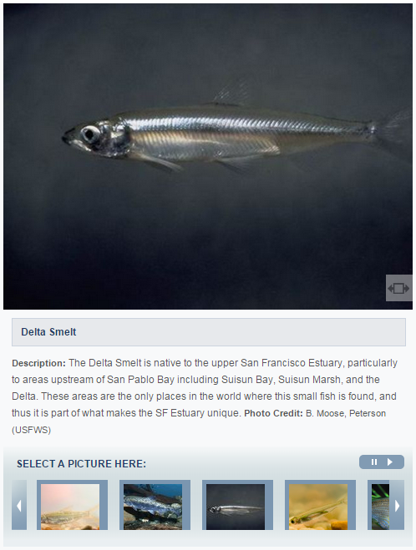
WATER QUALITY MONITORING COUNCIL
CALIFORNIA ESTUARIES PORTAL
Search
PORTALS
CA ESTUARIES
LEARN THE ISSUES
REPORTING
MANAGEMENT TOOLS
Fish
What Are they?
How are they monitored?
Reporting
SAN FRANCISCO BAY DELTA ESTUARY
The diverse habitats of SF Estuary support over 100 native and non-native species of fish. Although fishes demonstrate a wide spectrum of life-history characteristics, this portal groups species into the following categories:
Resident (the estuary is the primary residence habitat for all fish life stages)
Migratory (fish must transition between freshwater and the ocean to complete their life cycle)
Nursery (fish that reside primarily in the ocean as adults, but rear in the estuary)
Why Are Fish Important?
Fish in the SF Estuary are important for a variety of economic, cultural and ecological reasons. Recreational and commercial fisheries stimulate local economies. Commercially important fish include Chinook Salmon and Pacific Herring. Striped Bass and White Sturgeon are popular with sport anglers. Native Americans value fish resources such as Chinook Salmon and Pacific Lamprey for spiritual, cultural and economic purposes. A variety of species such as Northern Anchovy, smelts, herring, sculpins, and gobies serve an important role as forage species. Chinook Salmon adults provide nutrients as they decay in rivers after spawning. Measuring fish population size, distribution, or condition can be useful for monitoring changes within the estuary because fishes are responsive to changing environmental conditions. A large, divers fish assemblage that is distributed broadly throughout the estuary and dominated by native species is a good sign of a healthy estuary.

Slide 48
WATER QUALITY MONITORING COUNCIL
CALIFORNIA ESTUARIES PORTAL
Search
PORTALS
CA ESTUARIES
LEARN THE ISSUES
REPORTING
MANAGEMENT TOOLS
Fish
What Are they?
How are they monitored?
Reporting
SAN FRANCISCO BAY DELTA ESTUARY
The San Francisco Estuary fish fauna is surveyed regularly by numerous state and federally operated sampling programs. The methods used to survey fishes vary depending on fish behavior , fish size, and by the habitat (depth, substrate, vegetation) where they live. A list of the fish sampling programs are provided below (click for more information). New data sets are continuously uploaded to this portal as these data become available.
Learn more about the methods used to sample for fish in the San Francisco Estuary:
Year Round Surveys
San Francisco Bay Study (Bay Study)
Suisun Marsh Juvenile Fish Monitoring Survey
Fish Salvage Monitoring
Salmon Surveys
US Fish and Wildlife Service Surveys
Seasonal Surveys
Spring Kodiak Trawl
Smelt Larva Survey
20 mm Survey
Summer Townet Survey
Fall Midwater Trawl Survey
To view the locations of fish sampling stations in the map above, please select:
Monitoring Program?

Slide 49
WATER QUALITY MONITORING COUNCIL
CALIFORNIA ESTUARIES PORTAL
Search
PORTALS
CA ESTUARIES
LEARN THE ISSUES
REPORTING
MANAGEMENT TOOLS
How to label tab when no reporting is required?
Fish
SELECT DATA
What Are they?
How are they monitored?
Reporting
Where?
SAN FRANCISCO BAY DELTA ESTUARY
When?
The status and trends of fishes in the San Francisco Estuary are reported using several measures of population health, including the following:
Abundance is a common indicator of population health. Scientists and managers rely on standardized abundance indices that reveal population trends over time. Abundance indices for many native species are in decline.
Species composition is an indicator of population and ecosystem health. In particular, the fraction of the total number of species in the estuary that are non-native is a measure of estuarine health; non-native species are more likely to become established in damaged ecosystems and may exacerbate impacts by eating or competing with native species. The San Francisco Estuary has been described as one of the most invaded estuaries on Earth.
Spatial distribution of key life history stages is another important measure of population health. For example, the number of rivers where migratory fish spawn is important because a limited spatial distribution increases the risk to a population from local, catastrophic disturbances such as chemical spills and disease outbreaks. To explore the spatial distribution of fish in the San Francisco Estuary, click here.
What Species?
Understanding the relative abundance and distribution of fish in the San Francisco Bay Delta Estuary.
Station: X
X
Y
Species A
Count
Species B
Species C
Species D
Species E
Refer to dashboards (under “Management Tools”) when other interfaces are available.
Download: Graph Data Metadata
Station: Y
X
Y
Species A
Count
Species B
Species C
Species D
Species E
Download: Graph Data Metadata
Station: Z
X
Y
Species A
Count
Species B
Species C
Species D
Species E
Download: Graph Data Metadata

Slide 50
WATER QUALITY MONITORING COUNCIL
CALIFORNIA ESTUARIES PORTAL
Search
HOME
CA ESTUARIES
LEARN THE ISSUES
STATUS AND TRENDS
REPORTING
MANAGEMENT TOOLS
Safe
ABOUT US
STEWARDSHIP
WATER NEWS
What is the Estuary Monitoring Workgroup?
What is the Estuary Monitoring Workgroup?
What are headlines in California’s water news?
The California Estuary Monitoring Workgroup, is tasked with identifying key questions to assess the
It is every citizen’s responsibility acting as a steward in protecting the environment. The Sacramento
A new weather satellite was launched (February 27) from Japan aimed at providing high-tech, three
Ecological health of California’s Estuaries, the data and methods available and needed to address the questions, and the methods to access these data. Learn more
Regional County Sanitation District is in the process of purchasing and restoring habitat surrounding the their treatment plant…. Learn more
Dimensional snowfall around the earth. The Global Precipitation Measurements…. Learn more
HIGHLIGHTS
Safe
REPORTING
MANAGEMENT TOOLS
RESEARCH
What is the Water Quality Conditions Report?
How is salinity being managed during the drought?
How are tagged fish being used in the Delta?
This report summarizes the results of water quality monitoring and special studies conducted by the
Building data stories to communicate complicated topics. Learn about Salinity, why it is important and the
In support of various fish tracking studies by the Army Corp, USGS, MWD, DWR and participating
Environmental Monitoring Program within the Sacramento-San Joaquin Delta and Suisun Marsh, as mandated by Water Rights Decision 1641 (D-1641). Learn more
Management options available to the resource agencies. See real time conductivity conditions, visualize the salt field and spatially view….. Learn more
Agencies for management of receiver network ops and visualization of raw processed…. Learn more

Slide 51
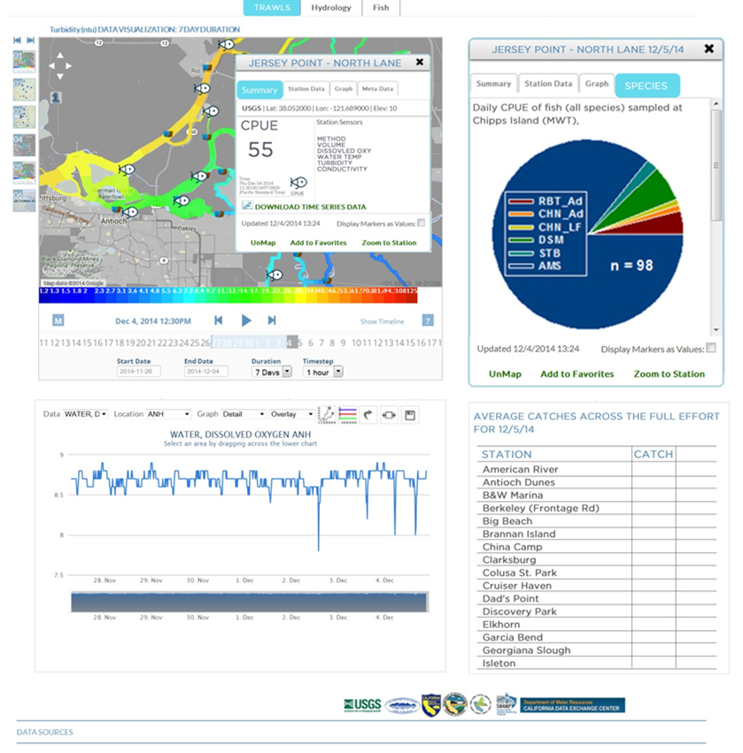
WATER QUALITY MONITORING COUNCIL
CALIFORNIA ESTUARIES PORTAL
Search
HOME
CA ESTUARIES
LEARN THE ISSUES
STATUS AND TRENDS
REPORTING
MANAGEMENT TOOLS
San Francisco Estuary
Delta Juvenile Fish Monitoring Program
Water Quality
Restoration Tracking
Santa Monica Bay
Elkhorn Slough
Morro Bay Estuary
Smith River Estuary
Klamath River Estuary
Mad River Estuary
Noyo River Estuary
Eel River Estuary
Russian River Estuary
Delta Juvenile Fish Monitoring Program
Catch data will be presented spatially, allowing users to easily visualize data; users can view expanded content by selecting specific trawl locations
Fish assemblage data will be available at specific locations in Delta within 3 days of sampling
Water quality data will be presented along with catch data for the period of interest

Slide 52
WATER QUALITY MONITORING COUNCIL
CALIFORNIA ESTUARIES PORTAL
Search
HOME
CA ESTUARIES
LEARN THE ISSUES
STATUS AND TRENDS
REPORTING
MANAGEMENT TOOLS
Delta Juvenile Fish Monitoring Program
Catch data will be presented spatially, allowing users to easily visualize data; users can view expanded content by selecting specific trawl locations
Fish assemblage data will be available at specific locations in Delta within 3 days of sampling
Water quality data will be presented along with catch data for the period of interest

Slide 53
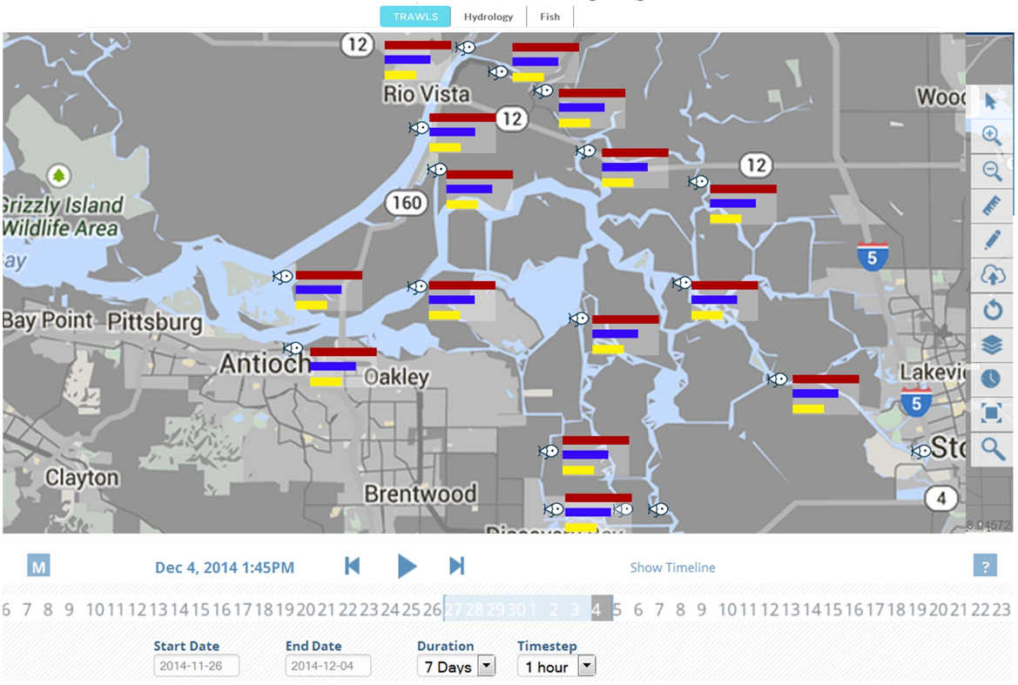
WATER QUALITY MONITORING COUNCIL
CALIFORNIA ESTUARIES PORTAL
Search
HOME
CA ESTUARIES
LEARN THE ISSUES
STATUS AND TRENDS
REPORTING
MANAGEMENT TOOLS
Delta Juvenile Fish Monitoring Program
Fish assemblage data will also be presented using bar or pie charts to illustrate relative abundance of species across the Delta for a period of interest.

Slide 54
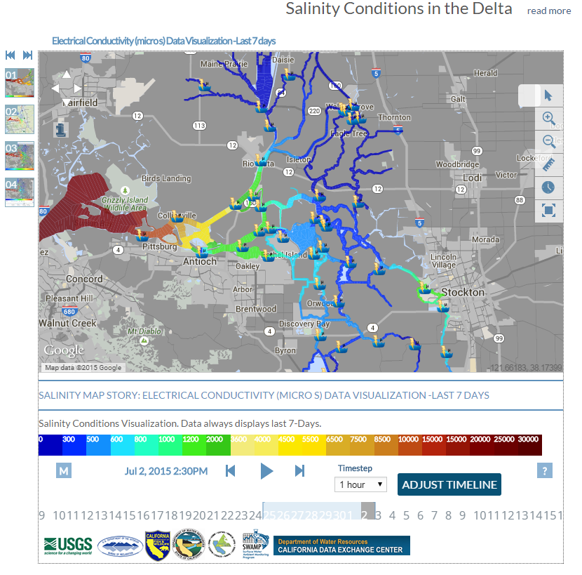
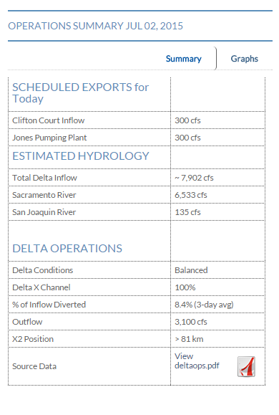
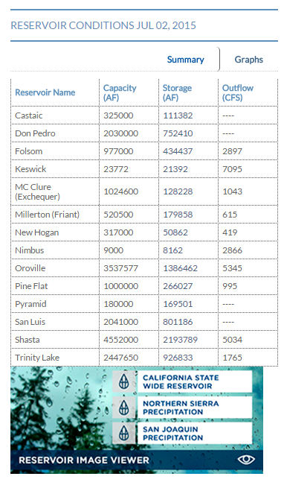
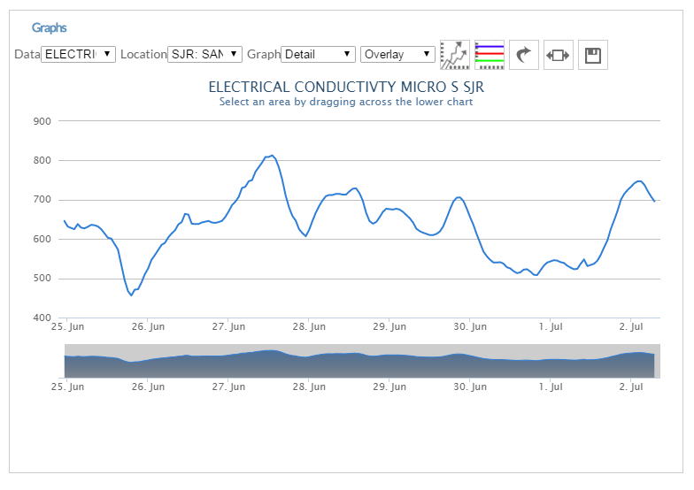
WATER QUALITY MONITORING COUNCIL
CALIFORNIA ESTUARIES PORTAL
Search
HOME
CA ESTUARIES
LEARN THE ISSUES
STATUS AND TRENDS
REPORTING
MANAGEMENT TOOLS
Water Quality
Summaries will be presented regarding real time operations.
Water quality maps will allow data visualization for: salinity, dissolved oxygen, turbidity, temperature etc.
Long term trends for water quality data will be visualized for the period and constituent of interest.

Slide 55
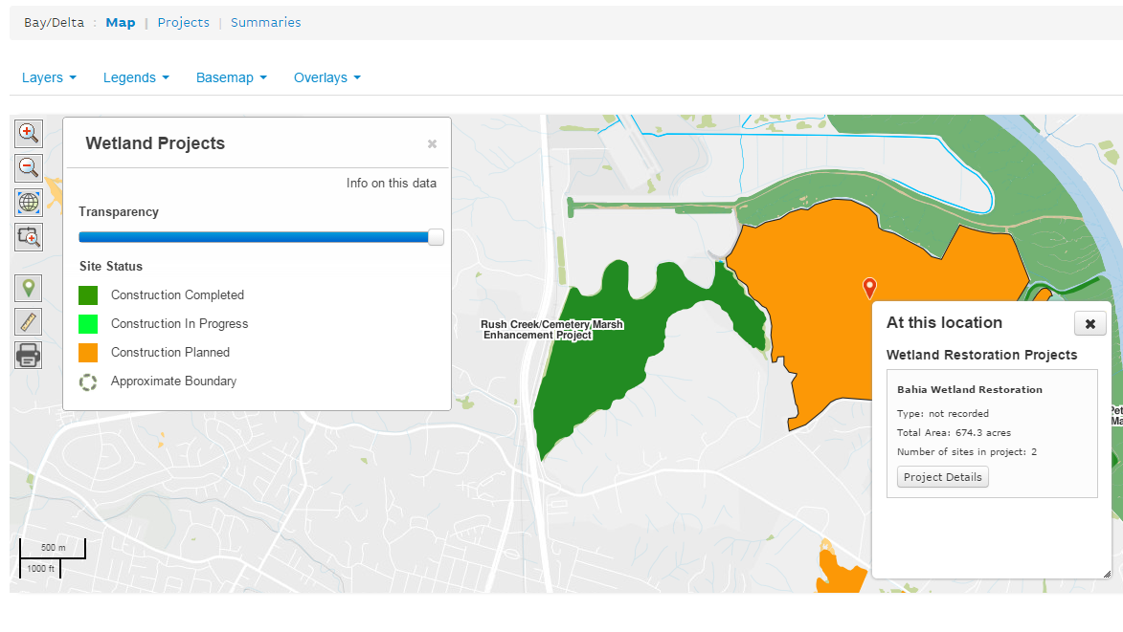
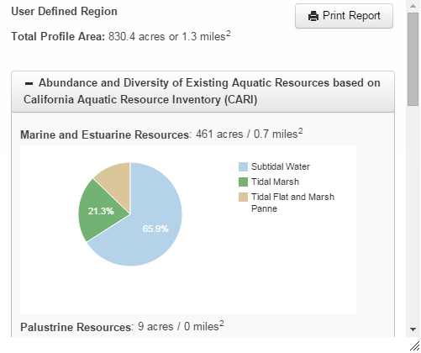
WATER QUALITY MONITORING COUNCIL
CALIFORNIA ESTUARIES PORTAL
Search
HOME
CA ESTUARIES
LEARN THE ISSUES
STATUS AND TRENDS
REPORTING
MANAGEMENT TOOLS
Restoration Tracking
To track restoration efforts, users can select projects using the mapping interface
GIS layers depict restoration status (e.g., planned, in progress, completed)
Monitoring Data
Landscape Summary
Monitoring data will be displayed, illustrating trends pre- and post- restoration
ZOOPLANKTON BIOMASS
Summary statistics and data will be provided for the restoration project of interest

Slide 56
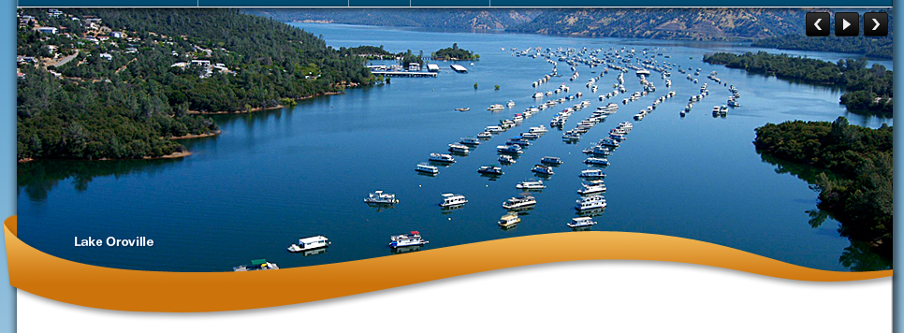

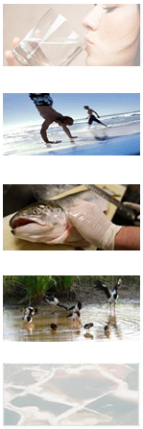

WATER QUALITY MONITORING COUNCIL
MY WATER QUALITY
Search
HOME
ABOUT US
WORKGROUPS AND PORTALS
PARTNERS
REPORTING
MANAGEMENT TOOLS
The California Water Quality Monitoring Council’s My Water Quality web portals are supported by a wide variety of public and private
organizations, presents California water quality monitoring data and assessment information that may be viewed across space and time. Initial web portal development concentrates on four them areas. Learn more
Safe
Is Our Water Safe to Drink?
Is It Safe to Swim in Our Waters?
Is it Safe to Eat Fish and Shellfish From Our Waters?
Safe drinking water depends on a variety of
Swimming safety of our waters is linked to the
Aquatic organisms are able to accumulate
chemical and biological factors regulated by a number of local, state, and federal agencies. [Future Portal]
levels of pathogens that have the potential to cause disease. Learn more
certain pollutants from the water in which they live, sometimes reaching levels that could harm consumers. Learn more
Safe
Are Our Aquatic Ecosystems Healthy?
What Stressors and Processes Affect Our Water Quality?
About Us
The health of fish and other aquatic organisms and
Beneficial uses of our waters are affected by emerging
The Monitoring Council seeks to provide multiple perspectives on water quality information and to highlight existing data gaps
communities depends on the chemical, physical, and biological quality of the waters in which they live. Learn more
Contaminants, invasive species, trash, global warming, acidification, pollutant loads, and flow. Learn more
and inconsistencies in data collection and interpretation. Learn more

Slide 57
WATER QUALITY MONITORING COUNCIL
MY WATER QUALITY
Search
HOME
ABOUT US
WORKGROUPS AND PORTALS
PARTNERS
REPORTING
MANAGEMENT TOOLS
The Estuary Monitoring Workgroup has released the latest version of DWR’s Water Quality Conditions Report.
Check out the new and improved interactive report, with increased access to real-time data from the Interagency Ecological Program’s Environmental Monitoring Program. Learn more
Safe
Is Our Water Safe to Drink?
Is It Safe to Swim in Our Waters?
Is it Safe to Eat Fish and Shellfish From Our Waters?
Safe drinking water depends on a variety of
Swimming safety of our waters is linked to the
Aquatic organisms are able to accumulate
chemical and biological factors regulated by a number of local, state, and federal agencies. [Future Portal]
levels of pathogens that have the potential to cause disease. Learn more
certain pollutants from the water in which they live, sometimes reaching levels that could harm consumers. Learn more
Safe
Are Our Aquatic Ecosystems Healthy?
What Stressors and Processes Affect Our Water Quality?
About Us
The health of fish and other aquatic organisms and
Beneficial uses of our waters are affected by emerging
The Monitoring Council seeks to provide multiple perspectives on water quality information and to highlight existing data gaps
communities depends on the chemical, physical, and biological quality of the waters in which they live. Learn more
Contaminants, invasive species, trash, global warming, acidification, pollutant loads, and flow. Learn more
and inconsistencies in data collection and interpretation. Learn more

Slide 58
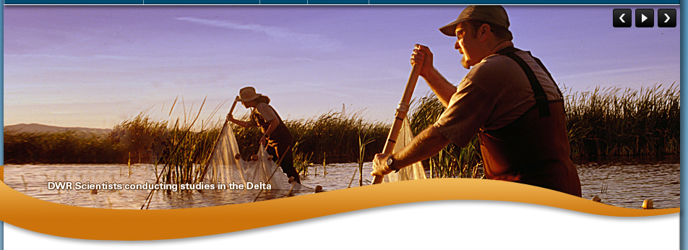
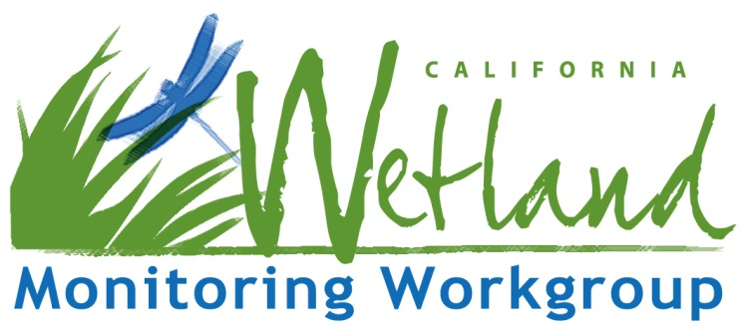
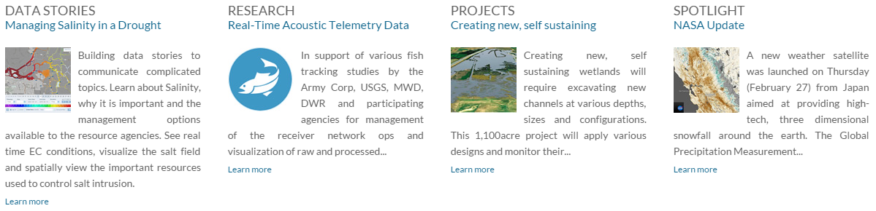
WATER QUALITY MONITORING COUNCIL
Wetland Monitoring Workgroup
Search
HOME
CA ESTUARIES
LEARN THE ISSUES
STATUS AND TRENDS
REPORTING
MANAGEMENT TOOLS
HIGHLIGHTS
RESEARCH
STEWARDSHIP
ABOUT US
Managing Salinity in a Drought
Real-Time Acoustic Telemetry Data
Creating new, self sustaining
The Estuaries Monitoring Workgroup

Slide 59
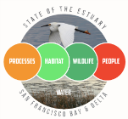
WATER QUALITY MONITORING COUNCIL
CALIFORNIA ESTUARIES PORTAL
Search
PORTALS
CA ESTUARIES
LEARN THE ISSUES
REPORTING
MANAGEMENT TOOLS
San Francisco Estuary
Benthic Invertebrates
Santa Monica Bay
Elkhorn Slough
Morro Bay Estuary
Smith River Estuary
Klamath River Estuary
Mad River Estuary
Noyo River Estuary
Eel River Estuary
Russian River Estuary
Safe
ABOUT US
STEWARDSHIP
WATER NEWS
What is the Estuary Monitoring Workgroup?
What is being done to protect California’s Estuaries?
What are headlines in California’s water news?
The California Estuary Monitoring Workgroup, is tasked with identifying key questions to assess the
It is every citizen’s responsibility acting as a steward in protecting the environment. The Sacramento
A new weather satellite was launched (February 27) from Japan aimed at providing high-tech, three
Ecological health of California’s Estuaries, the data and methods available and needed to address the questions, and the methods to access these data. Learn more
Regional County Sanitation District is in the process of purchasing and restoring habitat surrounding the their treatment plant…. Learn more
Dimensional snowfall around the earth. The Global Precipitation Measurements…. Learn more
Estuary Portal Homepage will highlight recent reports, e.g., SOTER
HIGHLIGHTS
Safe
REPORTING
MANAGEMENT TOOLS
RESEARCH
What is the State of the Estuary Report 2015?
How is salinity being managed during the drought?
How are tagged fish being used in the Delta?
The State of the Estuary Report is the
most comprehensive health report ever completed for
Building data stories to communicate complicated topics. Learn about Salinity, why it is important and the
In support of various fish tracking studies by the Army Corp, USGS, MWD, DWR and participating
for the San Francisco Bay-Delta Estuary. It uses the best available science and most recent data contributed by over 30 scientists….. Learn more
Management options available to the resource agencies. See real time conductivity conditions, visualize the salt field and spatially view….. Learn more
Agencies for management of receiver network ops and visualization of raw processed….. Learn more

Slide 60
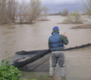
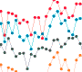

WATER QUALITY MONITORING COUNCIL
CALIFORNIA ESTUARIES PORTAL
Search
PORTALS
CA ESTUARIES
LEARN THE ISSUES
REPORTING
MANAGEMENT TOOLS
San Francisco Estuary
Benthic Invertebrates
Santa Monica Bay
Elkhorn Slough
Morro Bay Estuary
Smith River Estuary
Klamath River Estuary
Mad River Estuary
Noyo River Estuary
Eel River Estuary
Russian River Estuary
Users can access information/links regarding Bay-Delta Programs and Resources
Programs & Resources
Monitoring Programs
[DESCRIPTIVE TEXT]
CA Department of Fish and Wildlife
CA Department of Pesticide Regulation
CA Department of Water Resources
California Estuary Monitoring Workgroup
Interagency Ecological Program
Irrigated Lands Regulatory Program
Point Blue Conservation Science (PRBO)
San Francisco Bay Bird Observatory
San Francisco Bay Joint Venture
San Francisco Bay Regional Monitoring Program
San Francisco Estuary Invasive Spartina Project
Surface Water Ambient Monitoring Program
U.S. Fish and Wildlife Service
U.S. Geological Survey
Data Sources
[DESCRIPTIVE TEXT]
CA Environmental Data Exchange Network (CEDEN)
CA Data Exchange Center (CDEC)
CA Department of Water Resources Water Data Library
CA Department of Fish and Wildlife BIOS
CA Avian Data Center
CA Partners in Flight
CalFish
U.S. Geological Survey National Water Information System
U.S. Environmental Protection Agency STORET and Water Quality Exchange
SOTE Report can be accessed via link, which will take users to landing page.
Reports
[DESCRIPTIVE TEXT]
Delta
San Francisco Bay
Bay-Delta Strategic Workplan
CA Department of Fish and Wildlife Ecosystem Restoration Program Conservation Strategy
Delta Atlas
Delta Historical Ecology Study
Delta Science Plan
Delta Vision Foundation Report Card
Pelagic Organism Decline Reports
Public Policy Institute of California Reports
Pulse of the Delta
The State of the Bay-Delta, 2008
National Coastal Conditions Reports
Pulse of the Estuary
San Francisco Estuary Partnership Comprehensive Conservation Management Program
San Francisco Habitat Goals Projects
State of the Estuary Report
State of the Birds Report

Slide 61
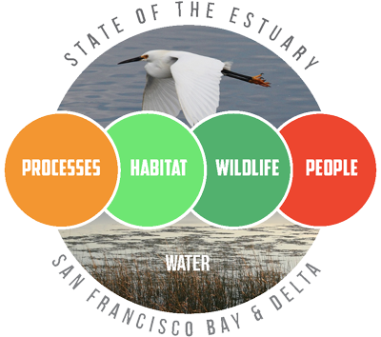
WATER QUALITY MONITORING COUNCIL
CALIFORNIA ESTUARIES PORTAL
Search
PORTALS
CA ESTUARIES
LEARN THE ISSUES
REPORTING
MANAGEMENT TOOLS
San Francisco Estuary
Benthic Invertebrates
Santa Monica Bay
Elkhorn Slough
Morro Bay Estuary
Smith River Estuary
Klamath River Estuary
Mad River Estuary
Noyo River Estuary
Eel River Estuary
Russian River Estuary
SOTER landing page, will provide 1) a brief description of the report; 2) ways to access the full report; and 3) links to the data on the portal used to develop indicators.
State of the Estuary Report 2015
The State of the Estuary Report is the most comprehensive health report ever completed for the San Francisco Bay-Delta Estuary. It uses the best available science and most recent data contributed by over 30 scientists to assess the status of various parts of the ecosystem. The purpose is to identify problems with estuarine health, so that conservation and restoration efforts can focus on solutions. This 2015 report expands on the scope of its predecessor in 2011, including Delta indicators for the first time, various new indicators for San Francisco Bay, and new sections linking the Estuary to the Gulf of the Farallones. The results show that the Upper Estuary (Suisun Bay and the Delta) is in critical condition. San Francisco Bay is in better health but jeopardized by climate change. Immediate action, significant investment, and bold changes to status quo management will be needed if we choose to recover and maintain a healthy estuary. To learn more about the report, click here.
Accessing the Report
The Report as a Flipbook – the flipbook integrates features such as text searching, bookmarking, and new enhancements, such as interactive charts and data stories.
The report as a PDF
The Executive Summary as a PDF
California Estuary Monitoring Workgroup’s Contributions
Through a collaborative effort, the California Estuary Monitoring Workgroup (CEMW) contributed to the development of the State of the Estuary Report 2015. CEMW members developed indicators, which assessed the status and trends for benthic invertebrates and zooplankton living in the San Francisco Bay-Delta Estuary. Data used to develop these indicators can be accessed through the Estuary Portal via the:
Benthic Invertebrate pages
Zooplankton pages

